Slide 1

Final Project Presentation
This project looks at the National Football League and the Elo rating systems while utilizing Monte Carlo simulation.
Author: Celeste Picone

Slide 2


Season Overview
The most notable aspect of the 2007 NFL season was that it was the first time that a team went undefeated in the regular season since it was extended to 16 games.
(This was the Patriots, so we don’t talk about it.)
The most exciting part of the 2007 season was when the undefeated New England Patriots lost to the 5th seed and wild card team, the New York Giants in Super Bowl 42.
Thus, we chose to analyze this season

Slide 3


Season Format
Regular season format:
2 conferences – AFC and NFC
4 divisions per conference – East, West, North, South
4 teams per division
16 game regular season
Playoff format:
The winners of each division within each conference make the playoffs and are seeded 1 – 4 based on season records
The top two teams in each conference who were not divisional winners are awarded a wild card spot and seeded 5 and 6
The 1 and 2 seed in each conference get a first-round bye

Slide 4
Preseason Elo Ratings
Team | Rating | Division
Indianapolis Colts | 1653.288 | afc_south
Los Angeles Chargers | 1642.486 | afc_west
New England Patriots | 1629.292 | afc_east
Baltimore Ravens | 1598.866 | afc_north
Pittsburgh Steelers | 1568.509 | afc_north
Denver Broncos | 1561.088 | afc_west
Jacksonville Jaguars | 1543.135 | afc_south
Kansas City Chiefs | 1537.513 | afc_west
Cincinnati Bengals | 1536.453 | afc_north
Buffalo Bills | 1506.520 | afc_east
New York Jets | 1504.903 | afc_east
Miami Dolphins | 1481.629 | afc_east
Tennessee Titans | 1479.929 | afc_south
Houston Texans | 1420.066 | afc_south
Cleveland Browns | 1392.302 | afc_north
Las Vegas Raiders | 1348.083 | afc_west
Chicago Bears | 1578.340 | nfc_north
Philadelphia Eagles | 1538.560 | nfc_east
Seattle Seahawks | 1516.631 | nfc_west
Carolina Panthers | 1513.113 | nfc_south
New Orleans Saints | 1509.904 | nfc_south
Dallas Cowboys | 1496.030 | nfc_east
New York Giants | 1495.183 | nfc_east
Green Bay Packers | 1483.404 | nfc_north
Los Angeles Rams | 1472.899 | nfc_west
Atlanta Falcons | 1450.484 | nfc_south
Washington Redskins | 1449.553 | nfc_east
Minnesota Vikings | 1439.949 | nfc_north
Arizona Cardinals | 1427.341 | nfc_west
San Francisco 49ers | 1425.134 | nfc_west
Tampa Bay Buccaneers | 1416.450 | nfc_south
Detroit Lions | 1378.642 | nfc_north
From these ratings alone, we would expect the Colts, Chargers, Patriots, and Ravens to be the playoff teams from the AFC
Steelers and Broncos awarded wild card spots
We would expect the NFC playoff teams to include the Bears, Eagles, Seahawks, and Panthers
Saints and Cowboys awarded wild card spots

Slide 5
Simulated Regular Season Results
Team | Simulated Wins | Actual Wins | Residuals
Buffalo Bills | 7.4440 | 7 | -0.4440
Miami Dolphins | 5.2713 | 1 | -4.2713
New England Patriots | 12.2248 | 16 | 3.7752
New York Jets | 6.2445 | 4 | -2.2445
Cincinnati Bengals | 8.1415 | 7 | -1.1415
Cleveland Browns | 7.1986 | 10 | 2.8014
Pittsburgh Steelers | 10.7611 | 10 | -0.7611
Baltimore Ravens | 8.2714 | 5 | -3.2714
Houston Texans | 6.3291 | 8 | 1.6709
Indianapolis Colts | 11.9733 | 13 | 1.0267
Jacksonville Jaguars | 9.2625 | 11 | 1.7375
Tennessee Titans | 8.1166 | 10 | 1.8834
Denver Broncos | 8.0025 | 7 | -1.0025
Kansas City Chiefs | 7.7616 | 4 | -3.7616
Los Angeles Chargers | 10.4913 | 11 | 0.5087
Las Vegas Raiders | 4.2393 | 4 | -0.2393
Dallas Cowboys | 10.1691 | 13 | 2.8309
New York Giants | 8.4847 | 10 | 1.5153
Philadelphia Eagles | 8.1214 | 8 | -0.1214
Washington Redskins | 6.9471 | 9 | 2.0529
Chicago Bears | 8.4740 | 7 | -1.4740
Detroit Lions | 5.9752 | 7 | 1.0248
Green Bay Packers | 9.8820 | 13 | 3.1180
Minnesota Vikings | 7.6026 | 8 | 0.3974
Atlanta Falcons | 5.8417 | 4 | -1.8417
Carolina Panthers | 7.3769 | 7 | -0.3769
New Orleans Saints | 8.2705 | 7 | -1.2705
Tampa Bay Buccaneers | 8.2110 | 9 | 0.7890
Arizona Cardinals | 7.2630 | 8 | 0.7370
Los Angeles Rams | 5.9077 | 3 | -2.9077
San Francisco 49ers | 5.6158 | 5 | -0.6158
Seattle Seahawks | 10.1239 | 10 | -0.1239

Slide 6
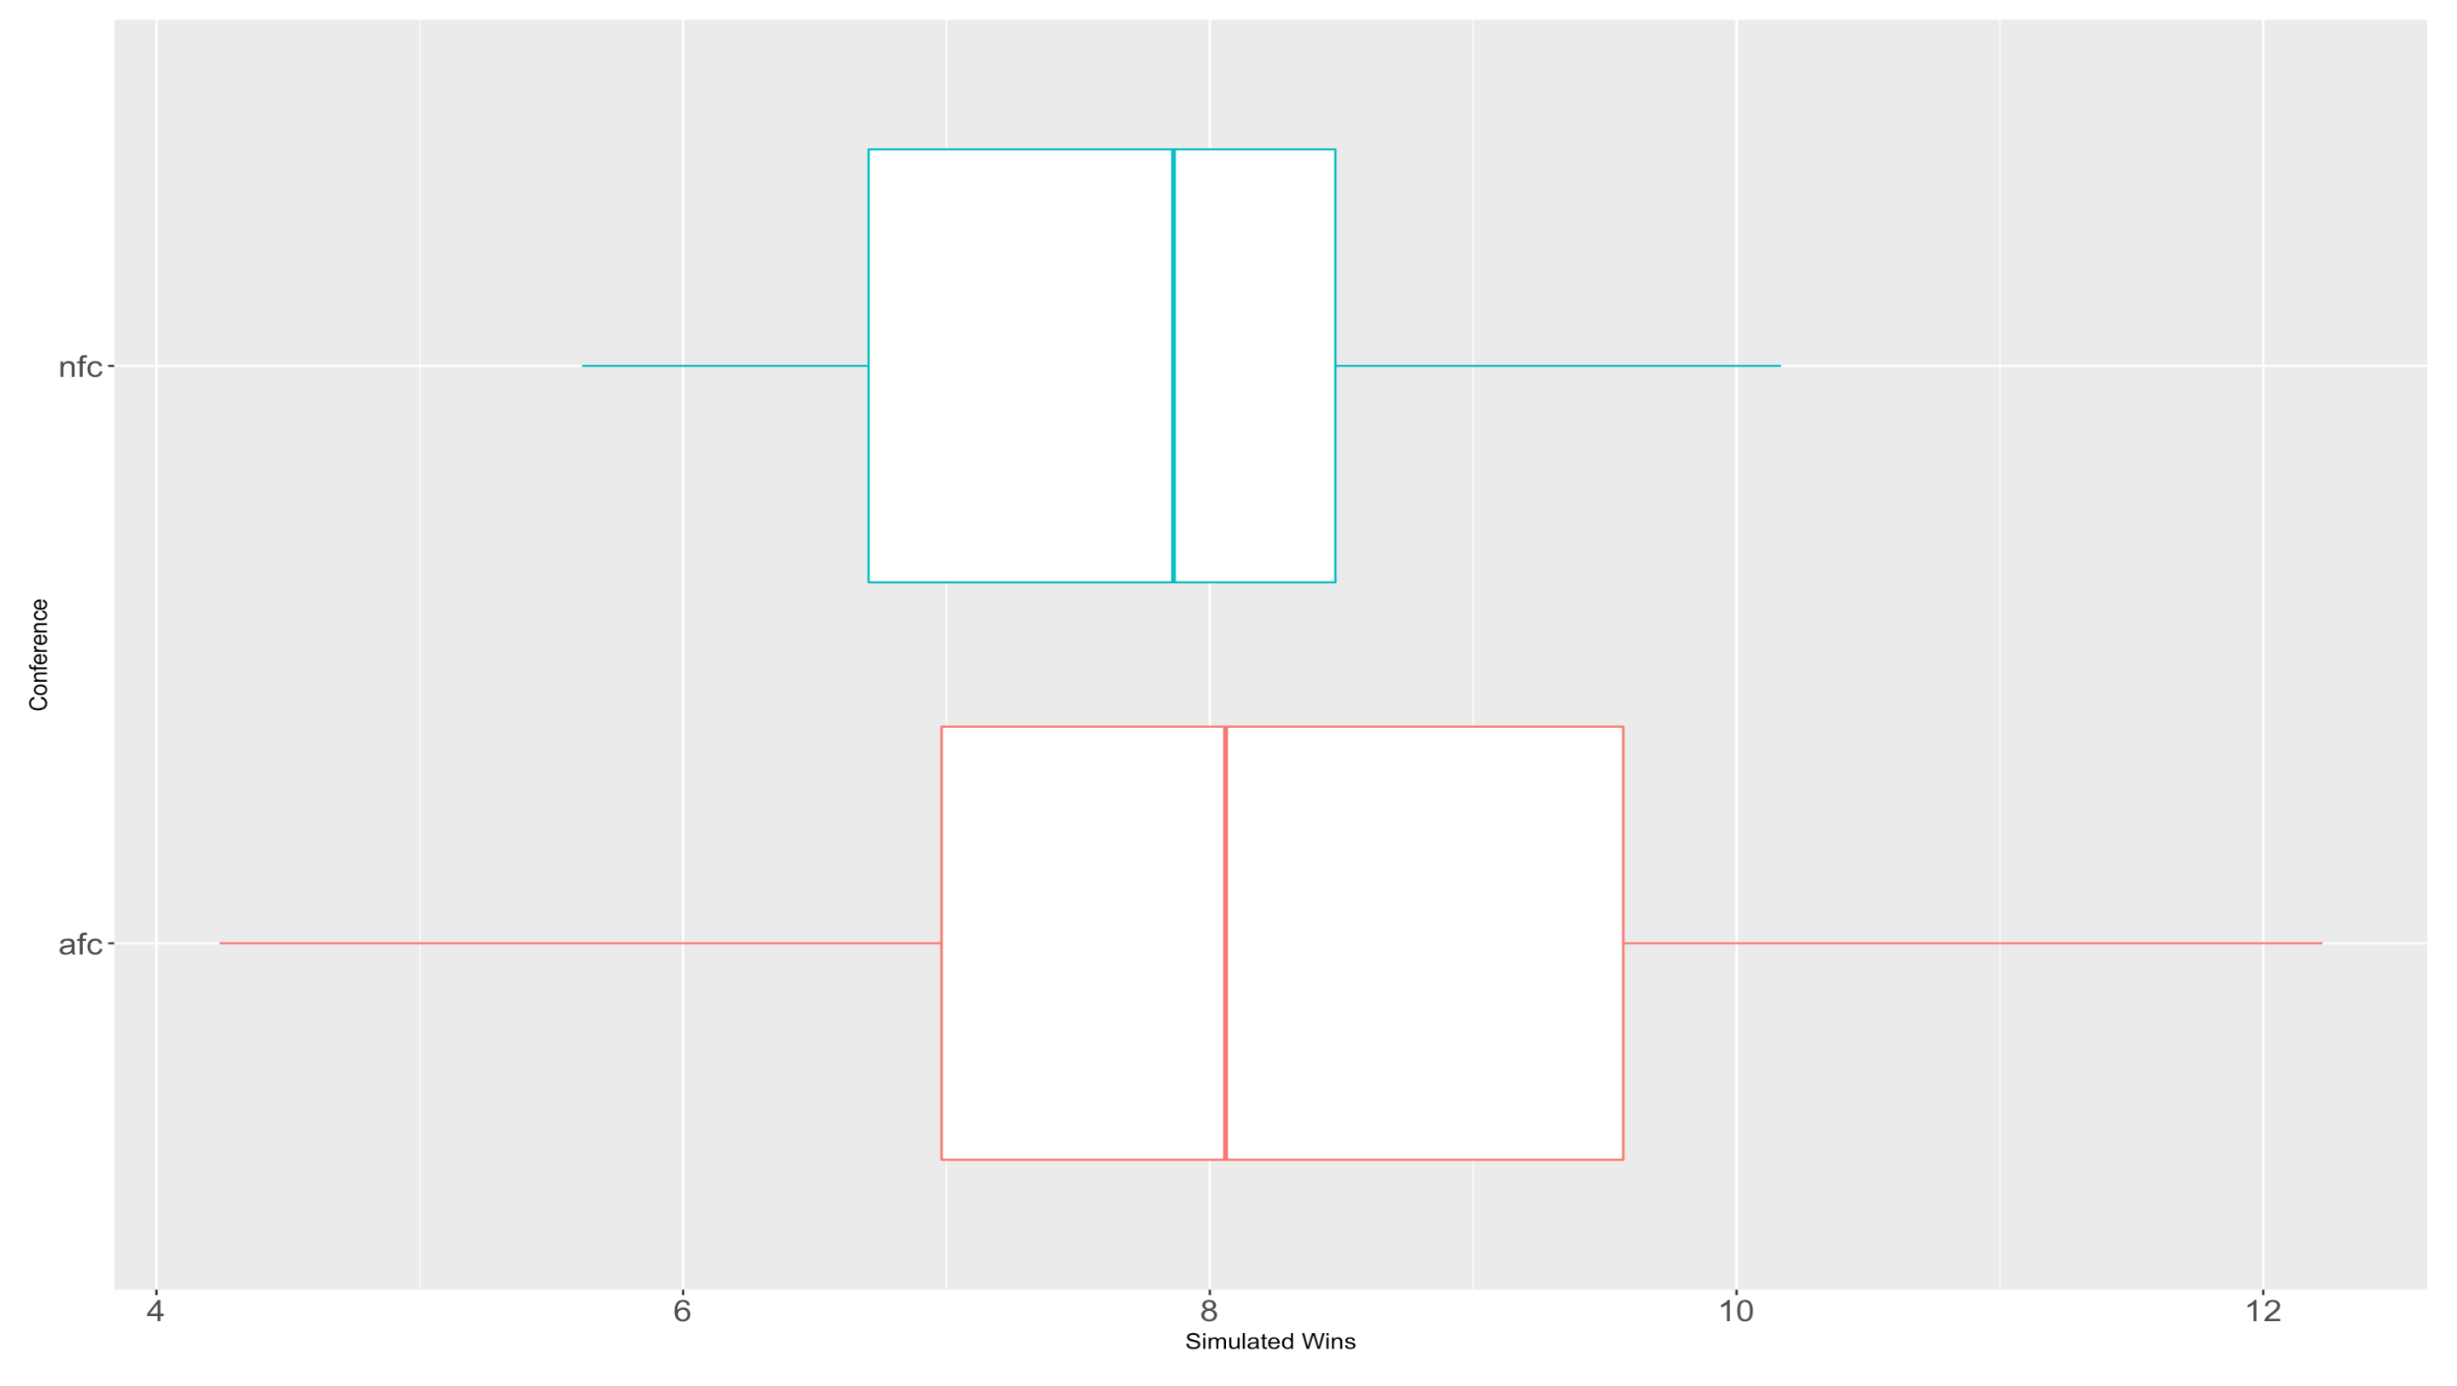
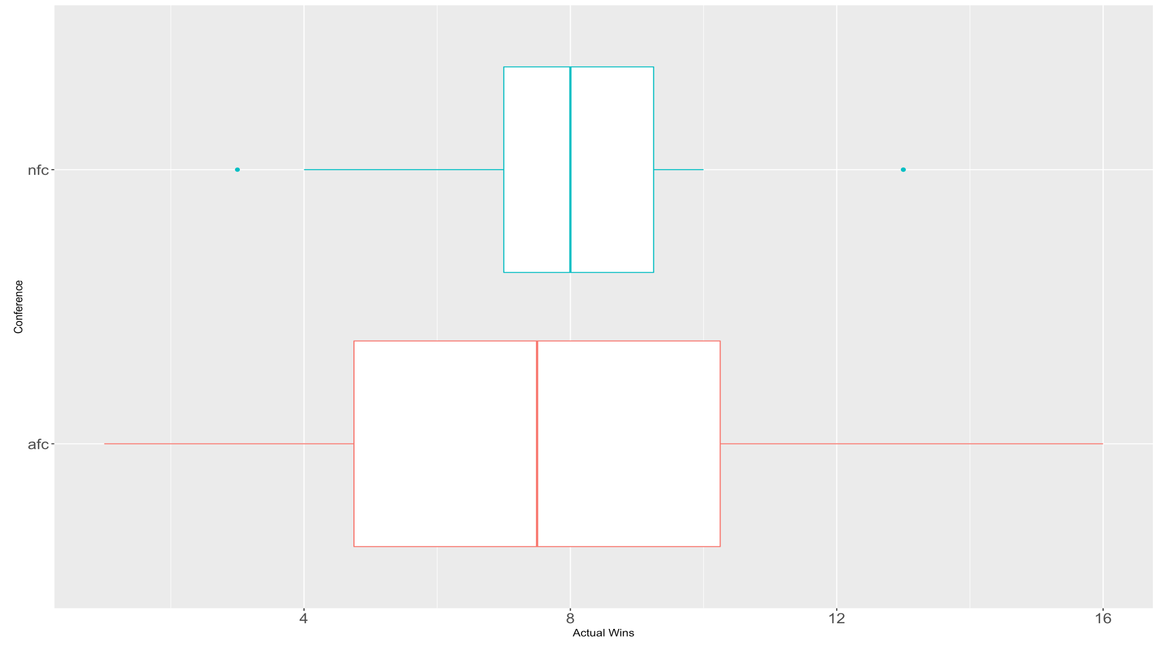
Comparison of Simulated and Actual Regular Seasons
These boxplots compare the number of wins (simulated or actual) across the two conferences.
In simulation and reality, the NFC had a much smaller spread than the AFC.
In reality, the NFC’s spread was larger than the simulation due to two outliers.
These were likely the Rams (3-13) and the Packers and Cowboys (13-3)
The AFC’s actual spread was around what was expected from the simulation.
Compared to the simulations, the actual mean wins was slightly higher for the NFC and slightly lower for the AFC
Takeaways:
NFC is more competitive within the conference than the AFC
Both conferences performed close to what was expected

Slide 7
Discussion of Regular Season Results
The Steelers, 49ers, Bills, Panthers, Raiders, Seahawks, Eagles, Vikings, Chargers, Cardinals, and Buccaneers all performed very close to what was expected
Residuals with an absolute value less than 1
In the simulated results, the Chicago Bears made it to the playoffs 47% of the time and the New Orleans Saints made the playoffs 48%.
In reality, neither did.
The Tennessee Titans and Washington Redskins made it to the playoffs in the 2007 season, but only 29% and 19% of the time in the simulation, respectively.
From looking at the preseason Elos and simulated wins, it was unexpected that the Dolphins would be the worst team in the league
We would have expected it to be the Raiders

Slide 8
Simulated Playoff Results
Team | Playoffs | Division Titles | Conference Championships | Championships | Preseason Rating | Final Rating
Buffalo Bills | 1766 | 385 | 20 | 6 | 1506.520 | 1457.850
Miami Dolphins | 193 | 36 | 0 | 0 | 1481.629 | 1303.766
New England Patriots | 9737 | 9454 | 4902 | 3934 | 1629.292 | 1822.058
New York Jets | 675 | 125 | 7 | 1 | 1504.903 | 1403.933
Cincinnati Bengals | 3018 | 1318 | 71 | 29 | 1536.453 | 1505.861
Cleveland Browns | 1519 | 609 | 38 | 16 | 1392.302 | 1509.771
Pittsburgh Steelers | 8134 | 6776 | 634 | 355 | 1568.509 | 1596.879
Baltimore Ravens | 3172 | 1297 | 35 | 17 | 1598.866 | 1439.383
Houston Texans | 722 | 111 | 24 | 12 | 1420.066 | 1511.146
Indianapolis Colts | 9398 | 7899 | 2590 | 1864 | 1653.288 | 1735.453
Jacksonville Jaguars | 5110 | 1434 | 420 | 225 | 1543.135 | 1621.788
Tennessee Titans | 2883 | 556 | 90 | 39 | 1479.929 | 1530.900
Denver Broncos | 2944 | 1572 | 51 | 16 | 1561.088 | 1469.910
Kansas City Chiefs | 2545 | 1247 | 12 | 2 | 1537.513 | 1367.365
Los Angeles Chargers | 8126 | 7153 | 1106 | 670 | 1642.486 | 1663.487
Las Vegas Raiders | 58 | 28 | 0 | 0 | 1348.083 | 1327.315
Dallas Cowboys | 7832 | 5742 | 2521 | 842 | 1496.030 | 1624.833
New York Giants | 4563 | 2007 | 682 | 158 | 1495.183 | 1536.290
Philadelphia Eagles | 3856 | 1567 | 639 | 176 | 1538.560 | 1559.036
Washington Redskins | 1977 | 684 | 302 | 89 | 1449.553 | 1556.435
Chicago Bears | 4687 | 2570 | 615 | 141 | 1578.340 | 1520.694
Detroit Lions | 834 | 297 | 26 | 1 | 1378.642 | 1392.083
Green Bay Packers | 7583 | 5800 | 2144 | 725 | 1483.404 | 1606.790
Minnesota Vikings | 2948 | 1333 | 300 | 57 | 1439.949 | 1503.382
Atlanta Falcons | 911 | 622 | 19 | 4 | 1450.484 | 1332.582
Carolina Panthers | 2927 | 2116 | 186 | 25 | 1513.113 | 1457.333
New Orleans Saints | 4774 | 3726 | 367 | 64 | 1509.904 | 1468.943
Tampa Bay Buccaneers | 4595 | 3536 | 387 | 65 | 1416.450 | 1480.088
Arizona Cardinals | 2544 | 1413 | 164 | 24 | 1427.341 | 1457.636
Los Angeles Rams | 902 | 484 | 18 | 1 | 1472.899 | 1334.480
San Francisco 49ers | 713 | 390 | 8 | 1 | 1425.134 | 1338.006
Seattle Seahawks | 8354 | 7713 | 1622 | 441 | 1516.631 | 1560.202

Slide 9
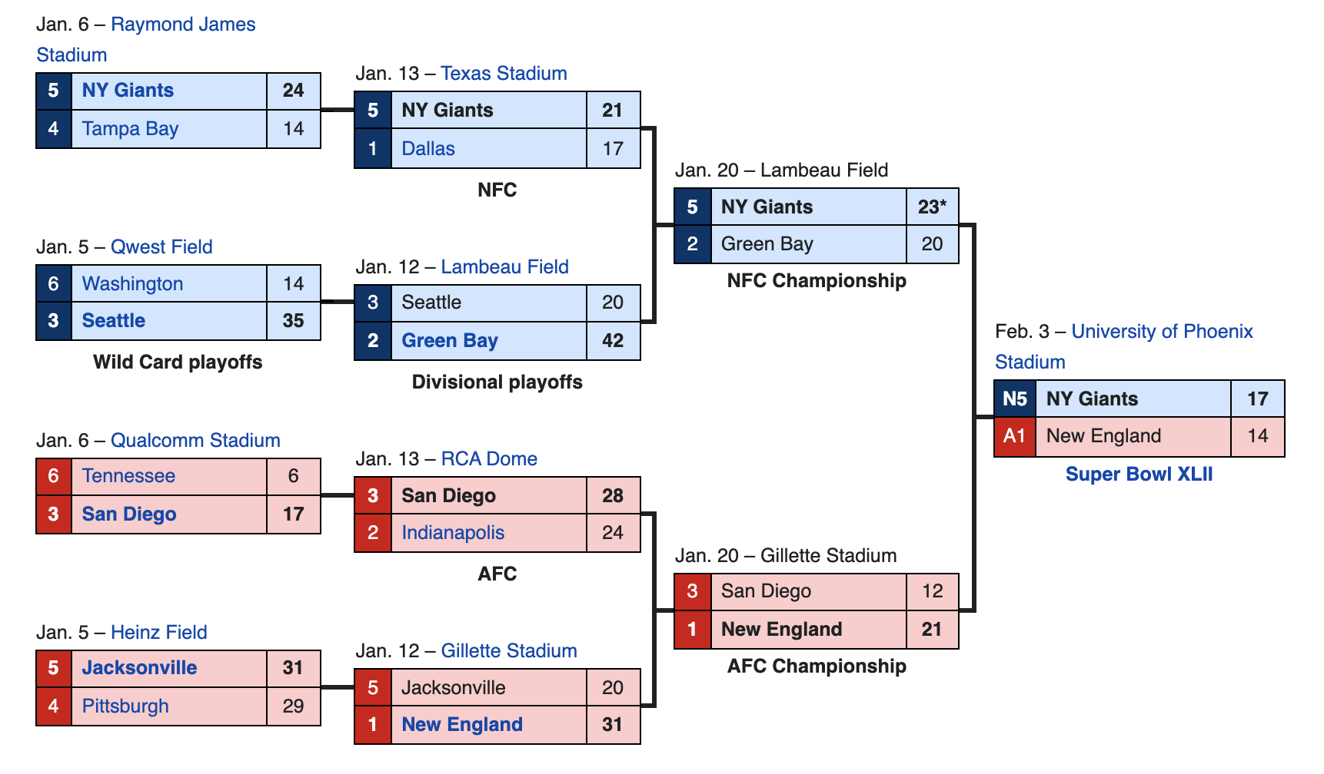










Actual Playoff Bracket
We see that the NY Giants won Super Bowl XLII

Slide 10
Comparison of Simulated and Actual Playoffs
The Patriots were expected to win the AFC and the Colts were expected to win the NFC
We expected the Super Bowl to be the Colts vs the Patriots
The Colts lost in the divisional playoffs
The most unusual result was the Giants defeating the Patriots in the Super Bowl
The simulation shows the Giants winning the championship 1.5% of the time and the Patriots 40% of the time.
The Giants run of even making it to the Super Bowl was the very unexpected, not to mention, them winning the Super Bowl

Slide 11
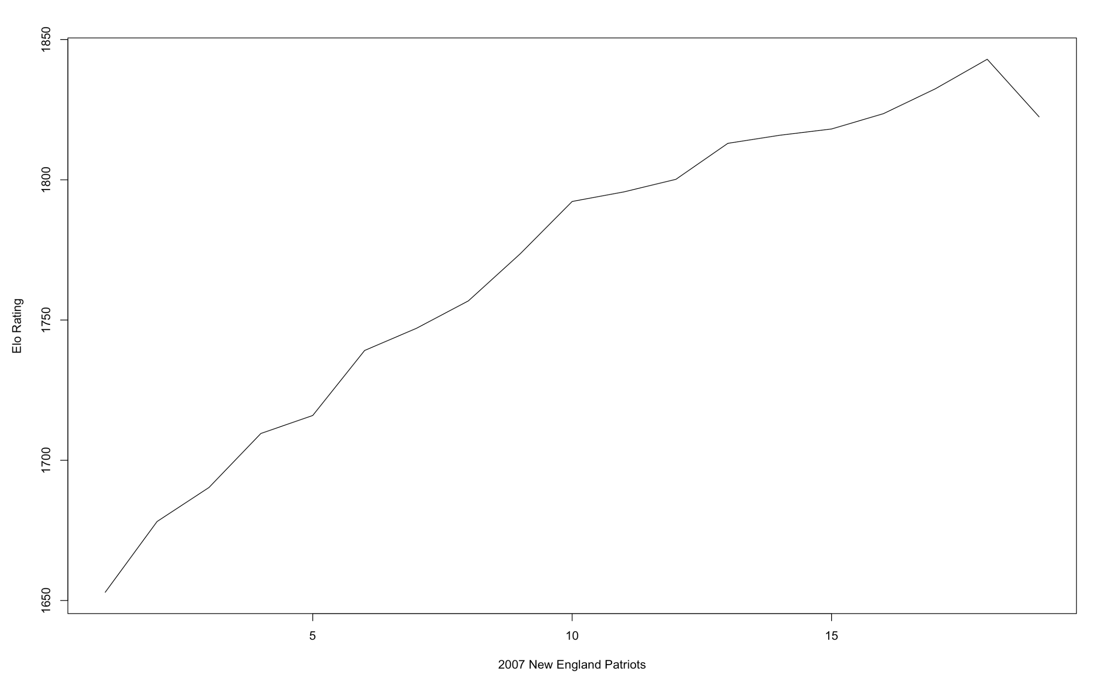
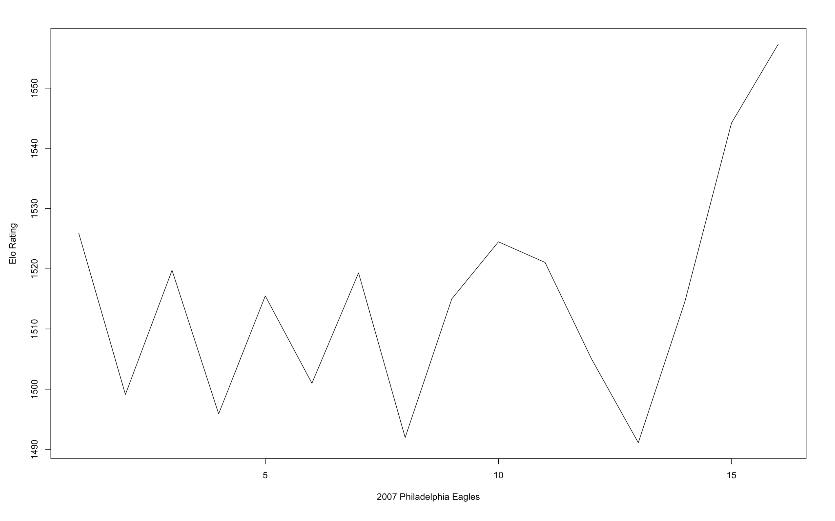


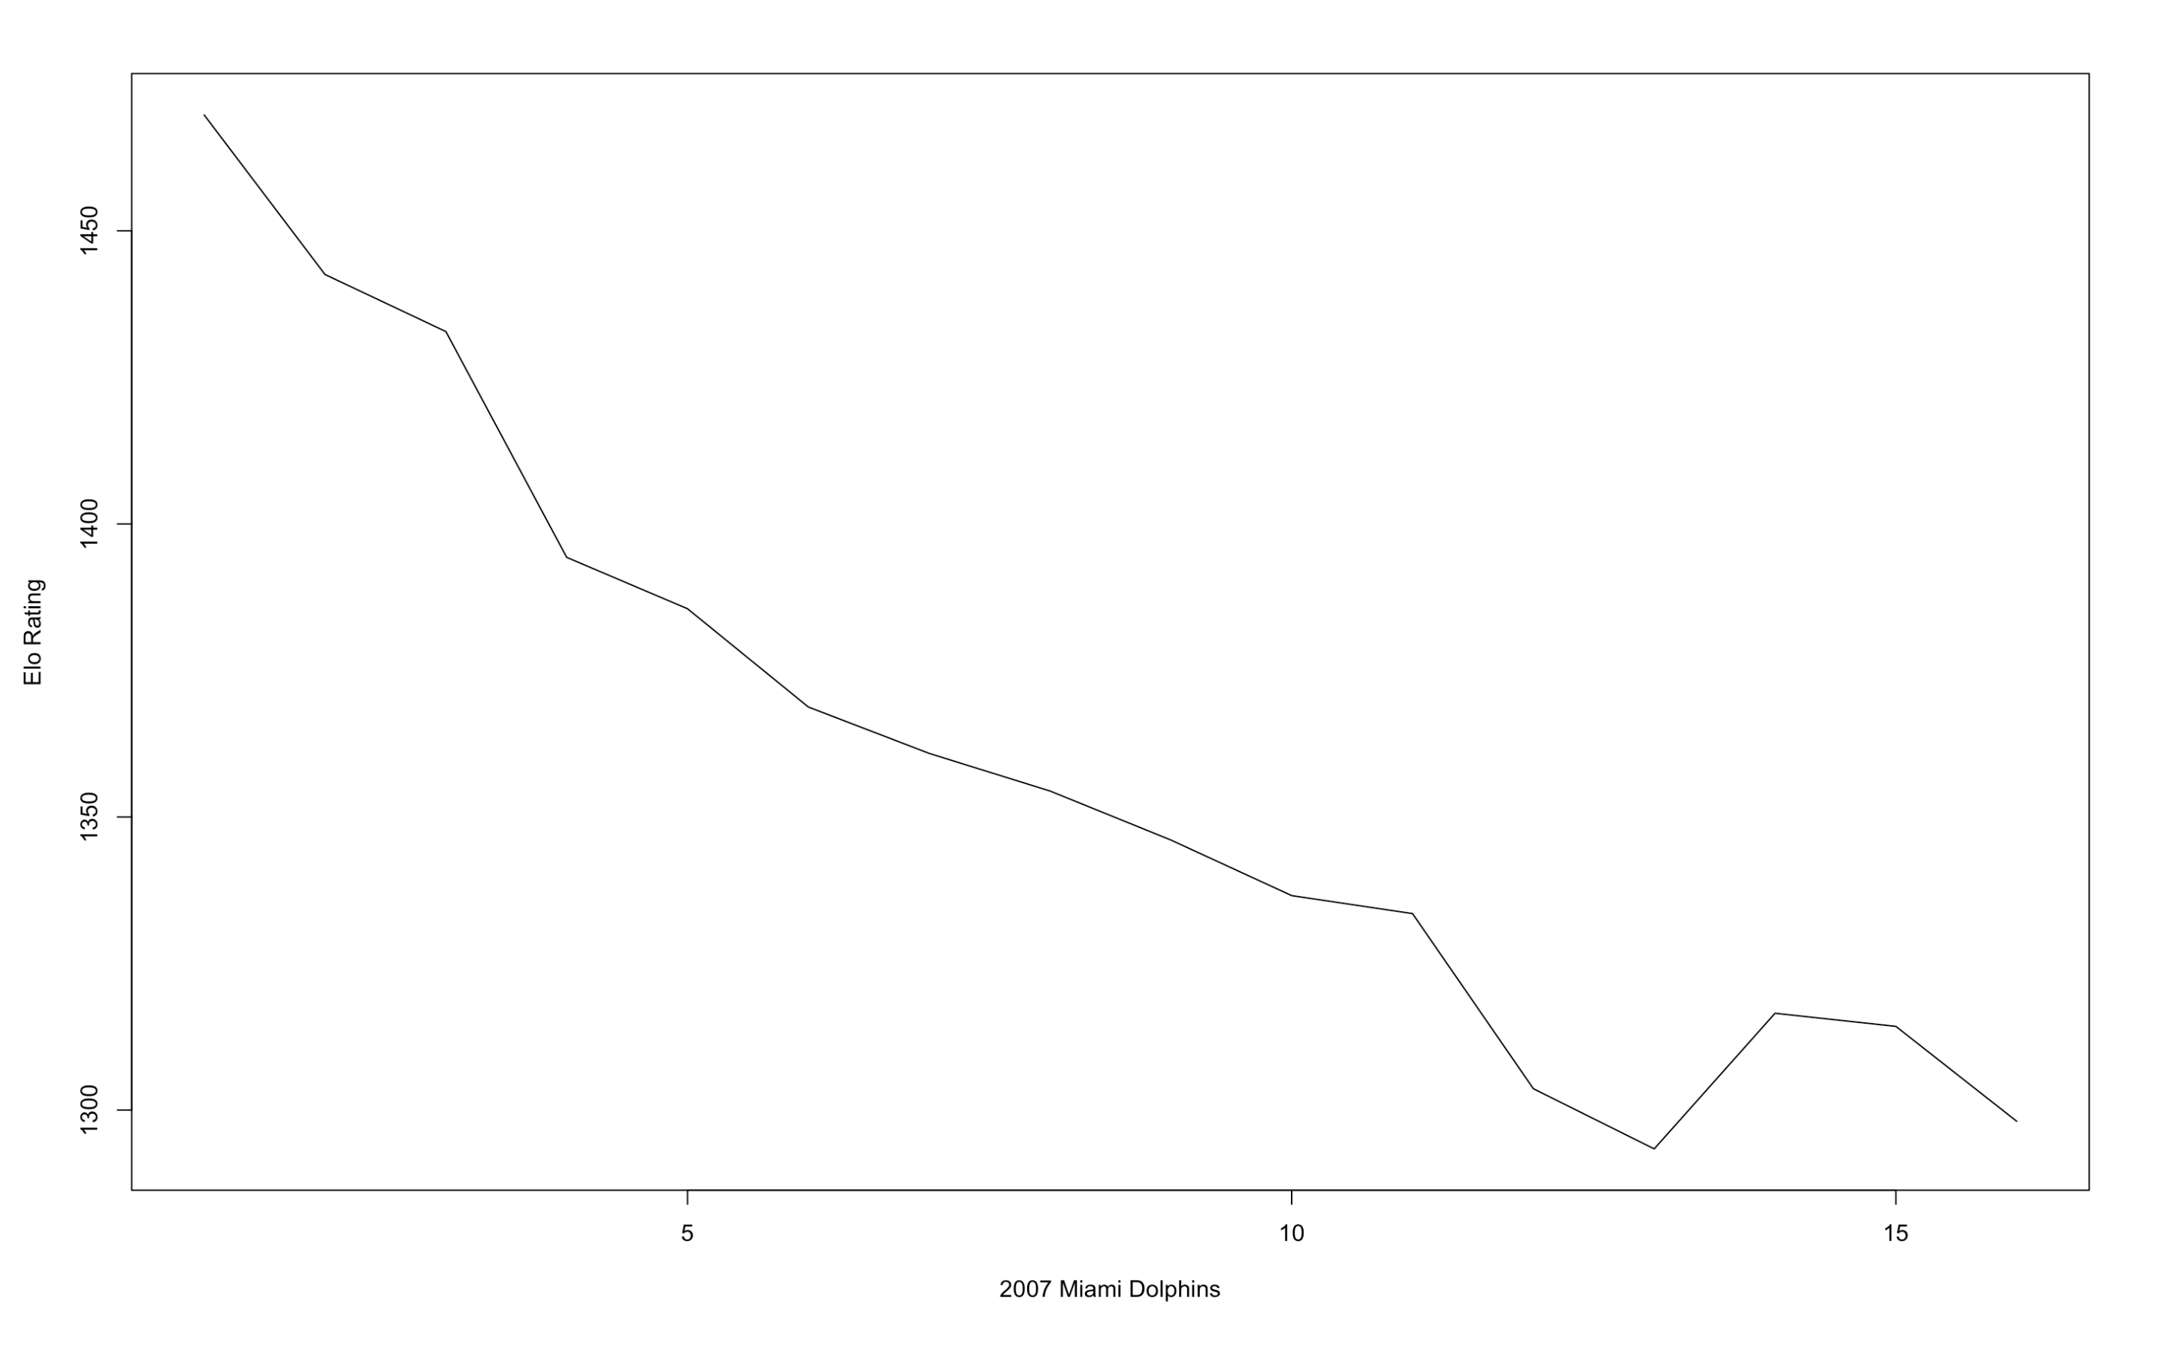
Three Teams Overview
Overachiever – New England Patriots
Simulated record: (12 – 4) vs Actual record: (16 - 0)
Simulated playoffs:
97.37% chance of playoff appearance
94.54% chance of division title
49.02% chance of conference championship
39.34% chance of Super Bowl championship
Actual Playoffs: Lost in Super Bowl
On Par – Philadelphia Eagles
Simulated record: (8 – 8) vs Actual record: (8 - 8)
Simulated playoffs:
38.56% chance of playoff appearance
15.67% chance of division title
6.39% chance of conference championship
1.76% chance of Super Bowl championship
Actual Playoffs: Did not make the playoffs
Underachiever – Miami Dolphins
Simulated record: (5 - 11) vs Actual record: (1 - 15)
Simulated playoff:
1.93% chance of playoff appearance
0.36% chance of division title
0% chance of conference championship
0% chance of Super Bowl championship
Actual Playoffs: Did not make the playoffs

Slide 12
Relevant Statistics
Total QBR
Defensive Count Statistics
Percentage of Opponent’s Offensive drives resulting in scores
Points allowed
Total yards allowed

Slide 13
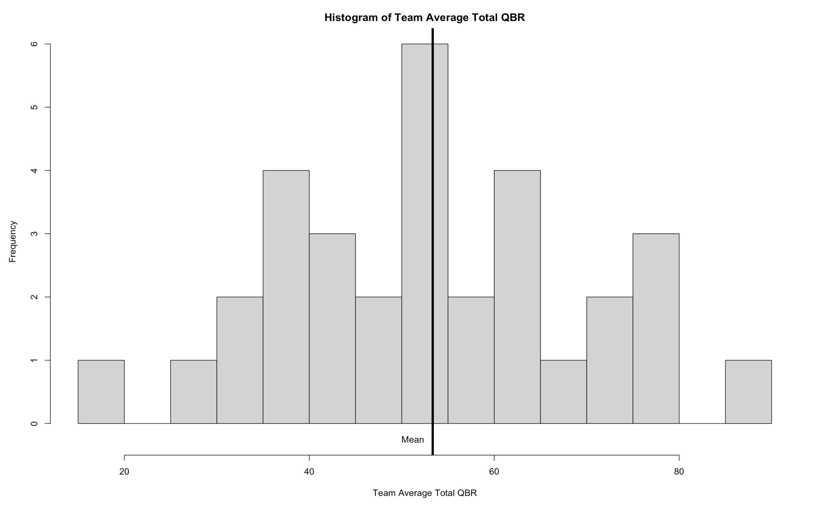
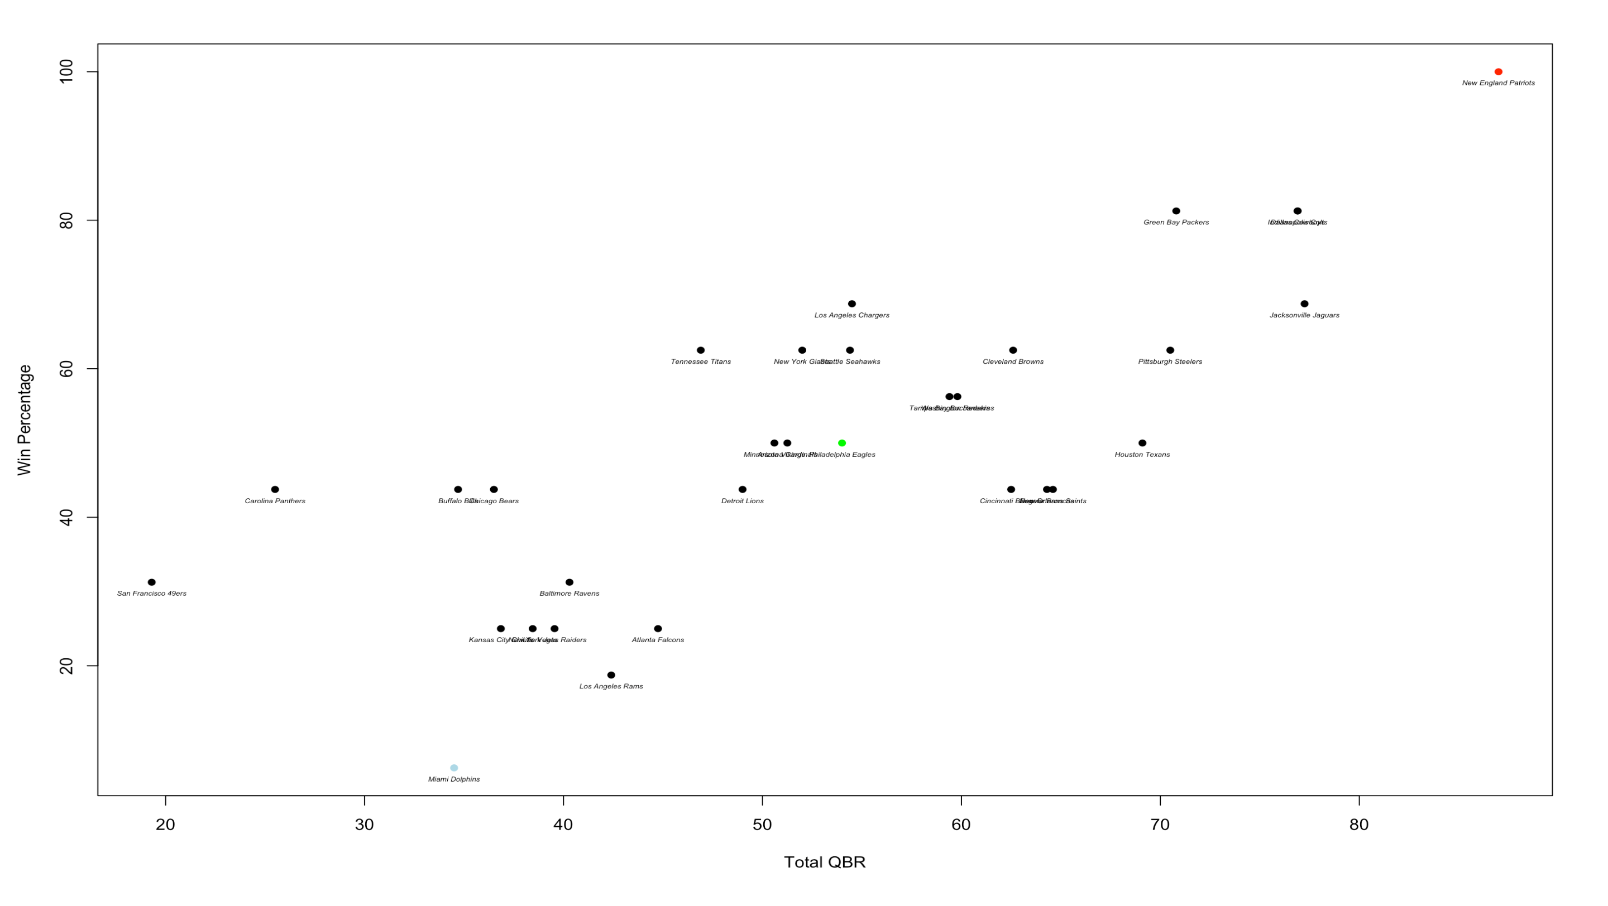
Relevant Statistics: Total QBR
We can see that Total QBR is strongly, positively correlated with Win Percentage
R = 0.7752922

Slide 14
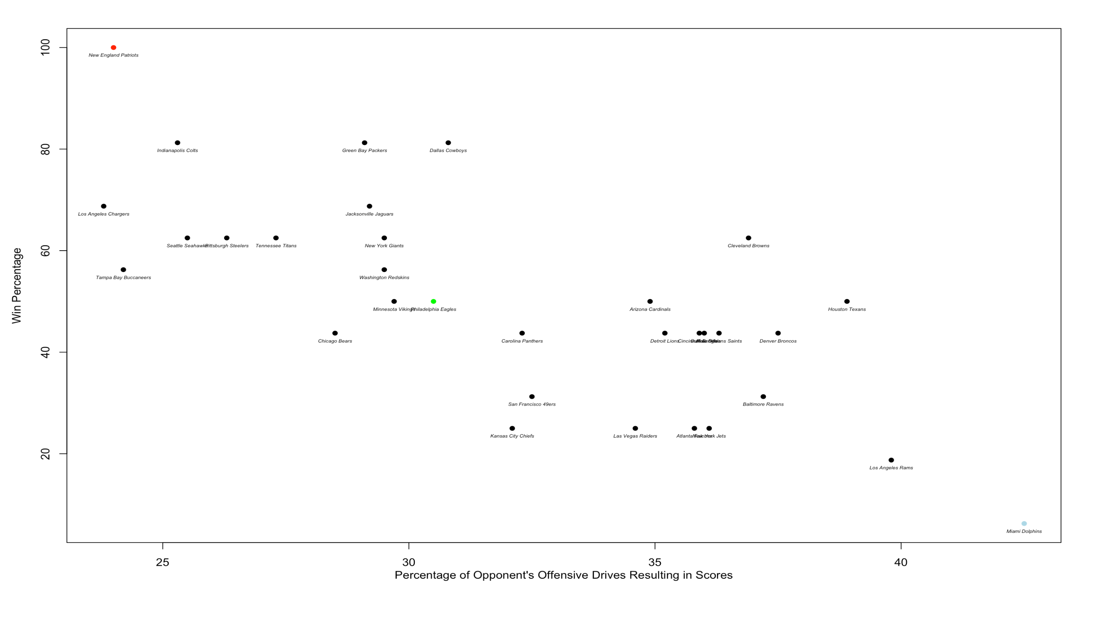
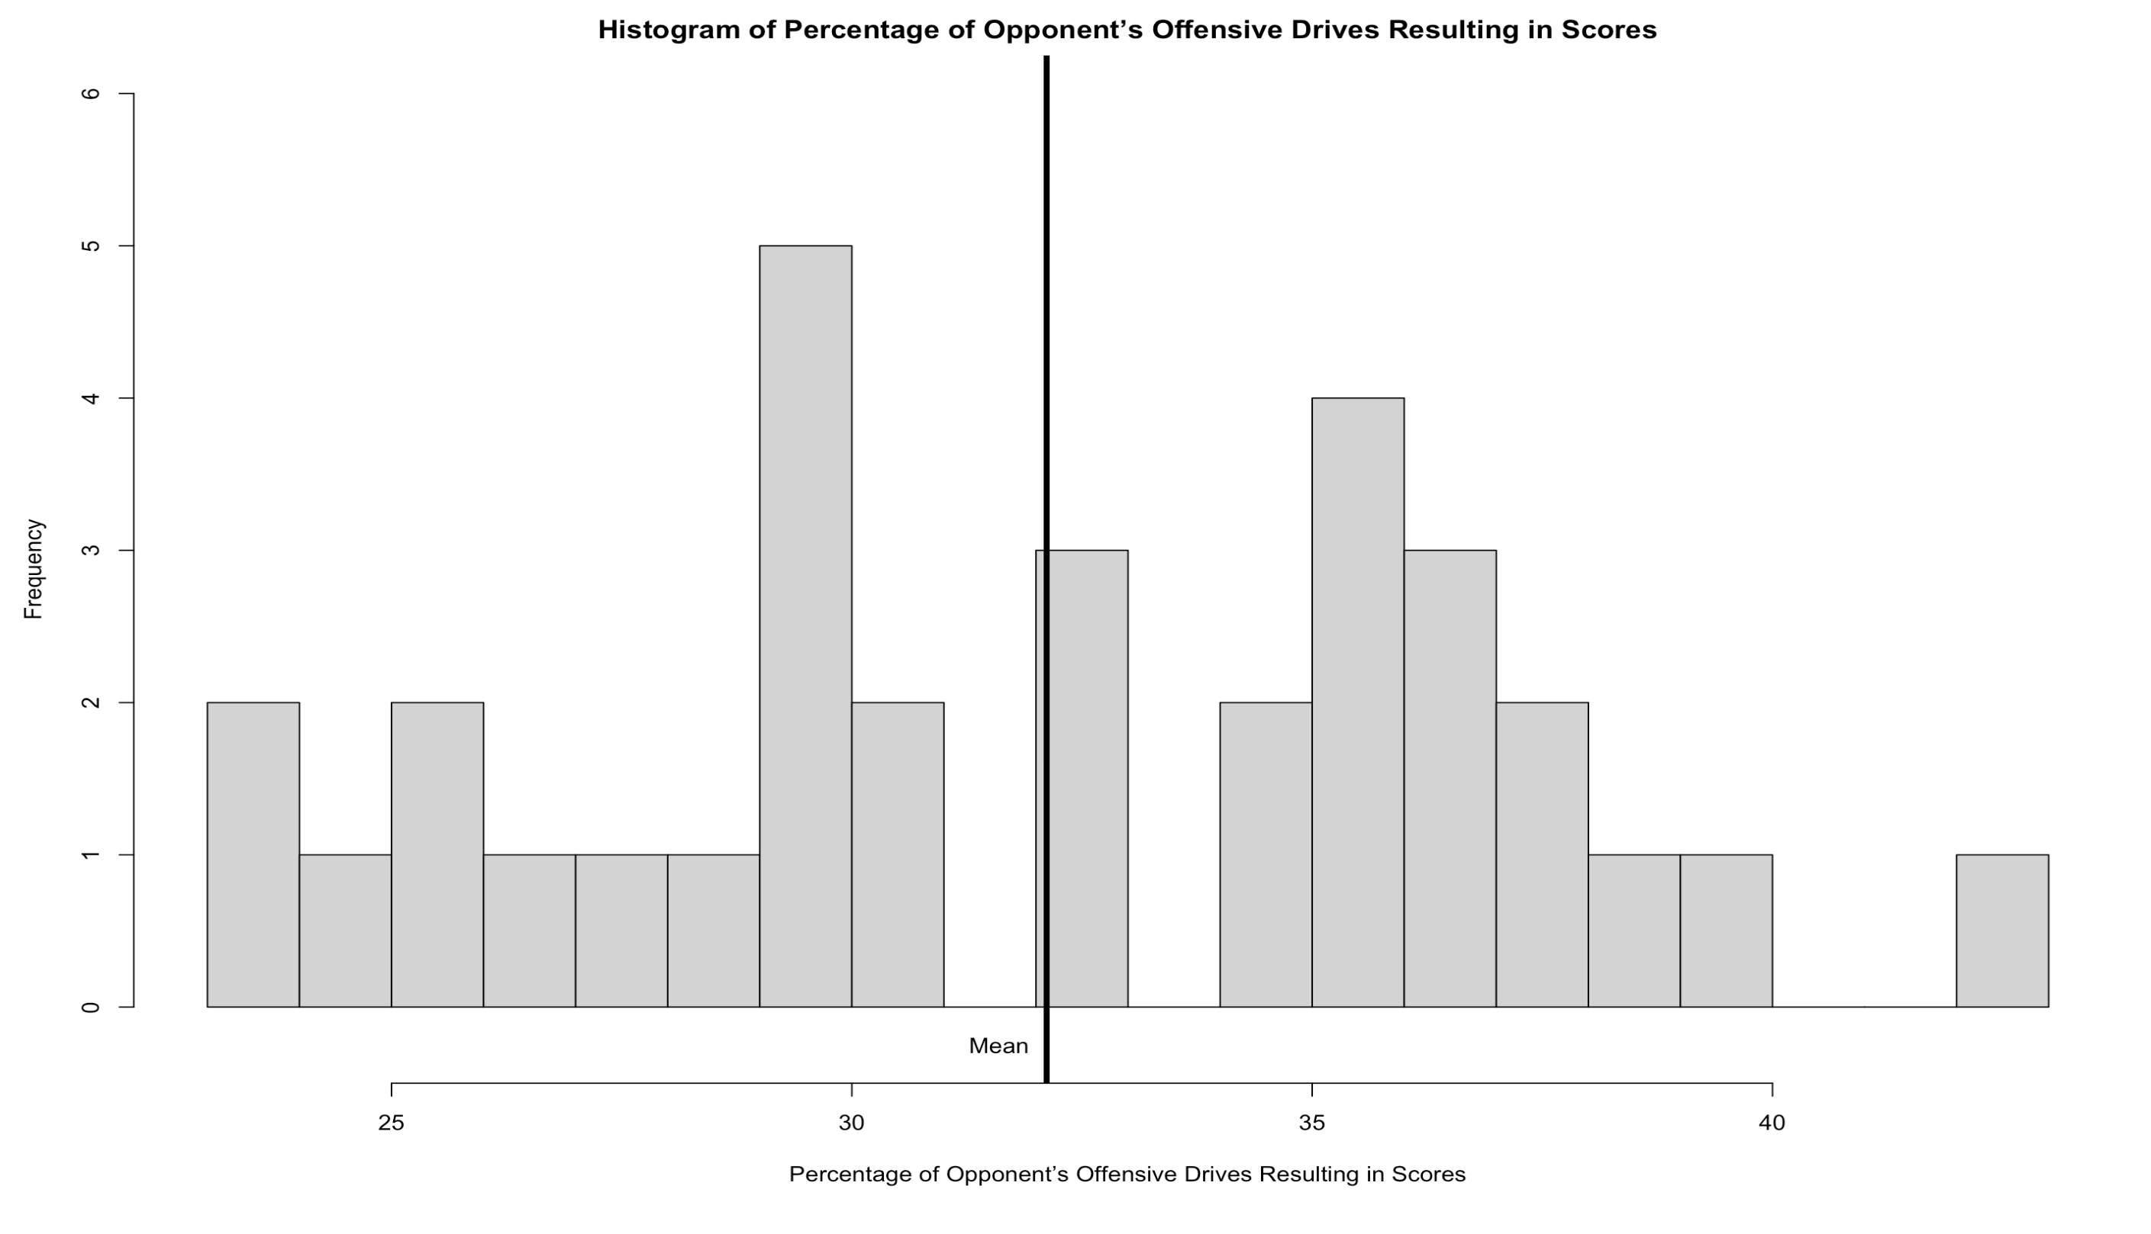
Relevant Statistics: Percentage of Opponent’s Offensive drives resulting in scores
We can see that the Percentage of Opponent’s Offensive Drives Resulting in Scores is strongly, negatively correlated with Win Percentage
R = -0.73103792

Slide 15
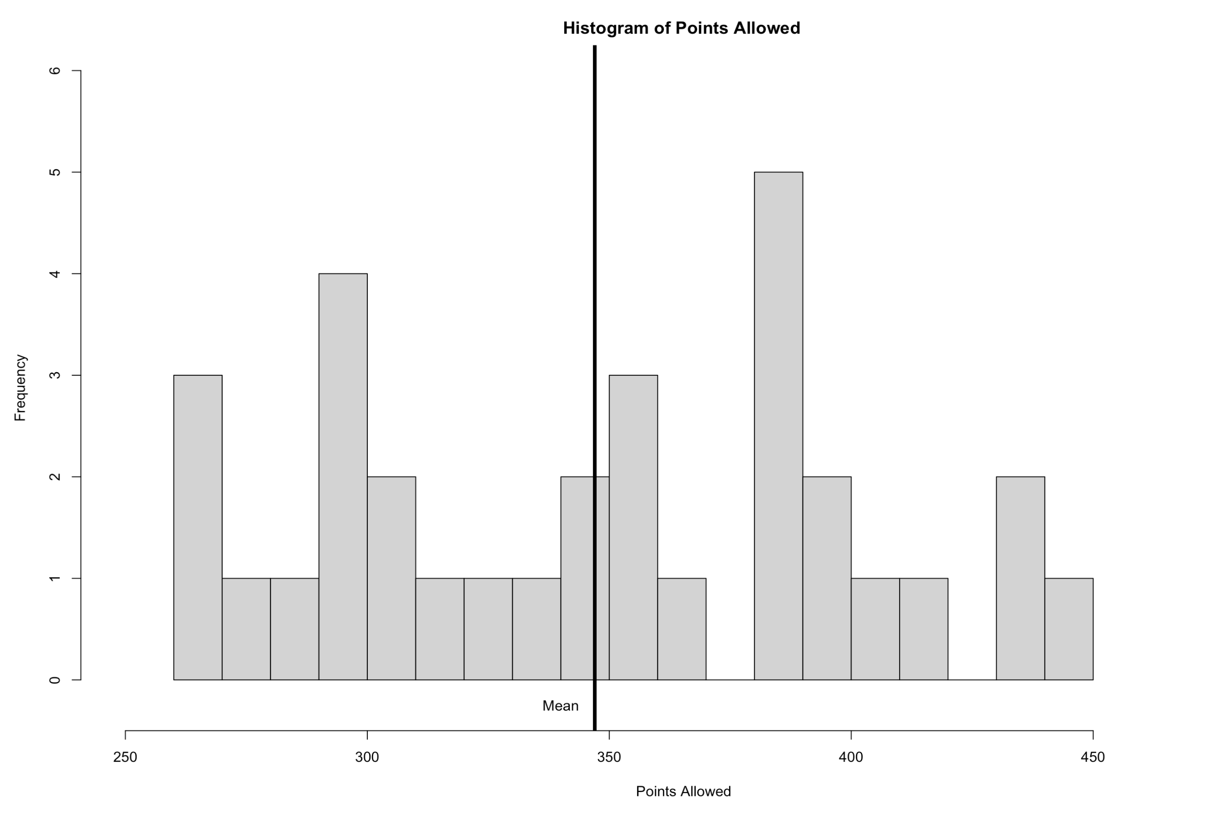
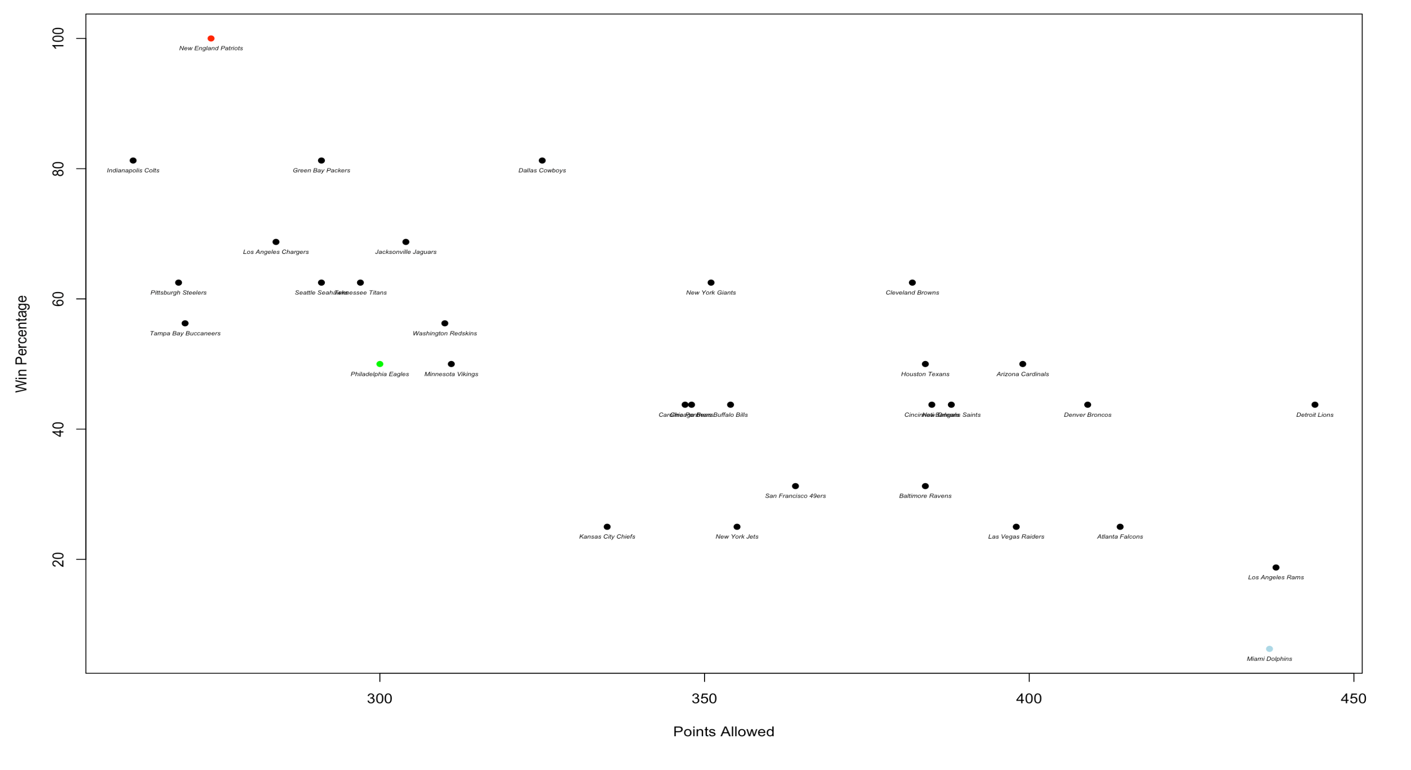
Relevant Statistics: Points Allowed
We can see that the Points Allowed has a moderate, negative correlation with Win Percentage
R = -0.72718991

Slide 16
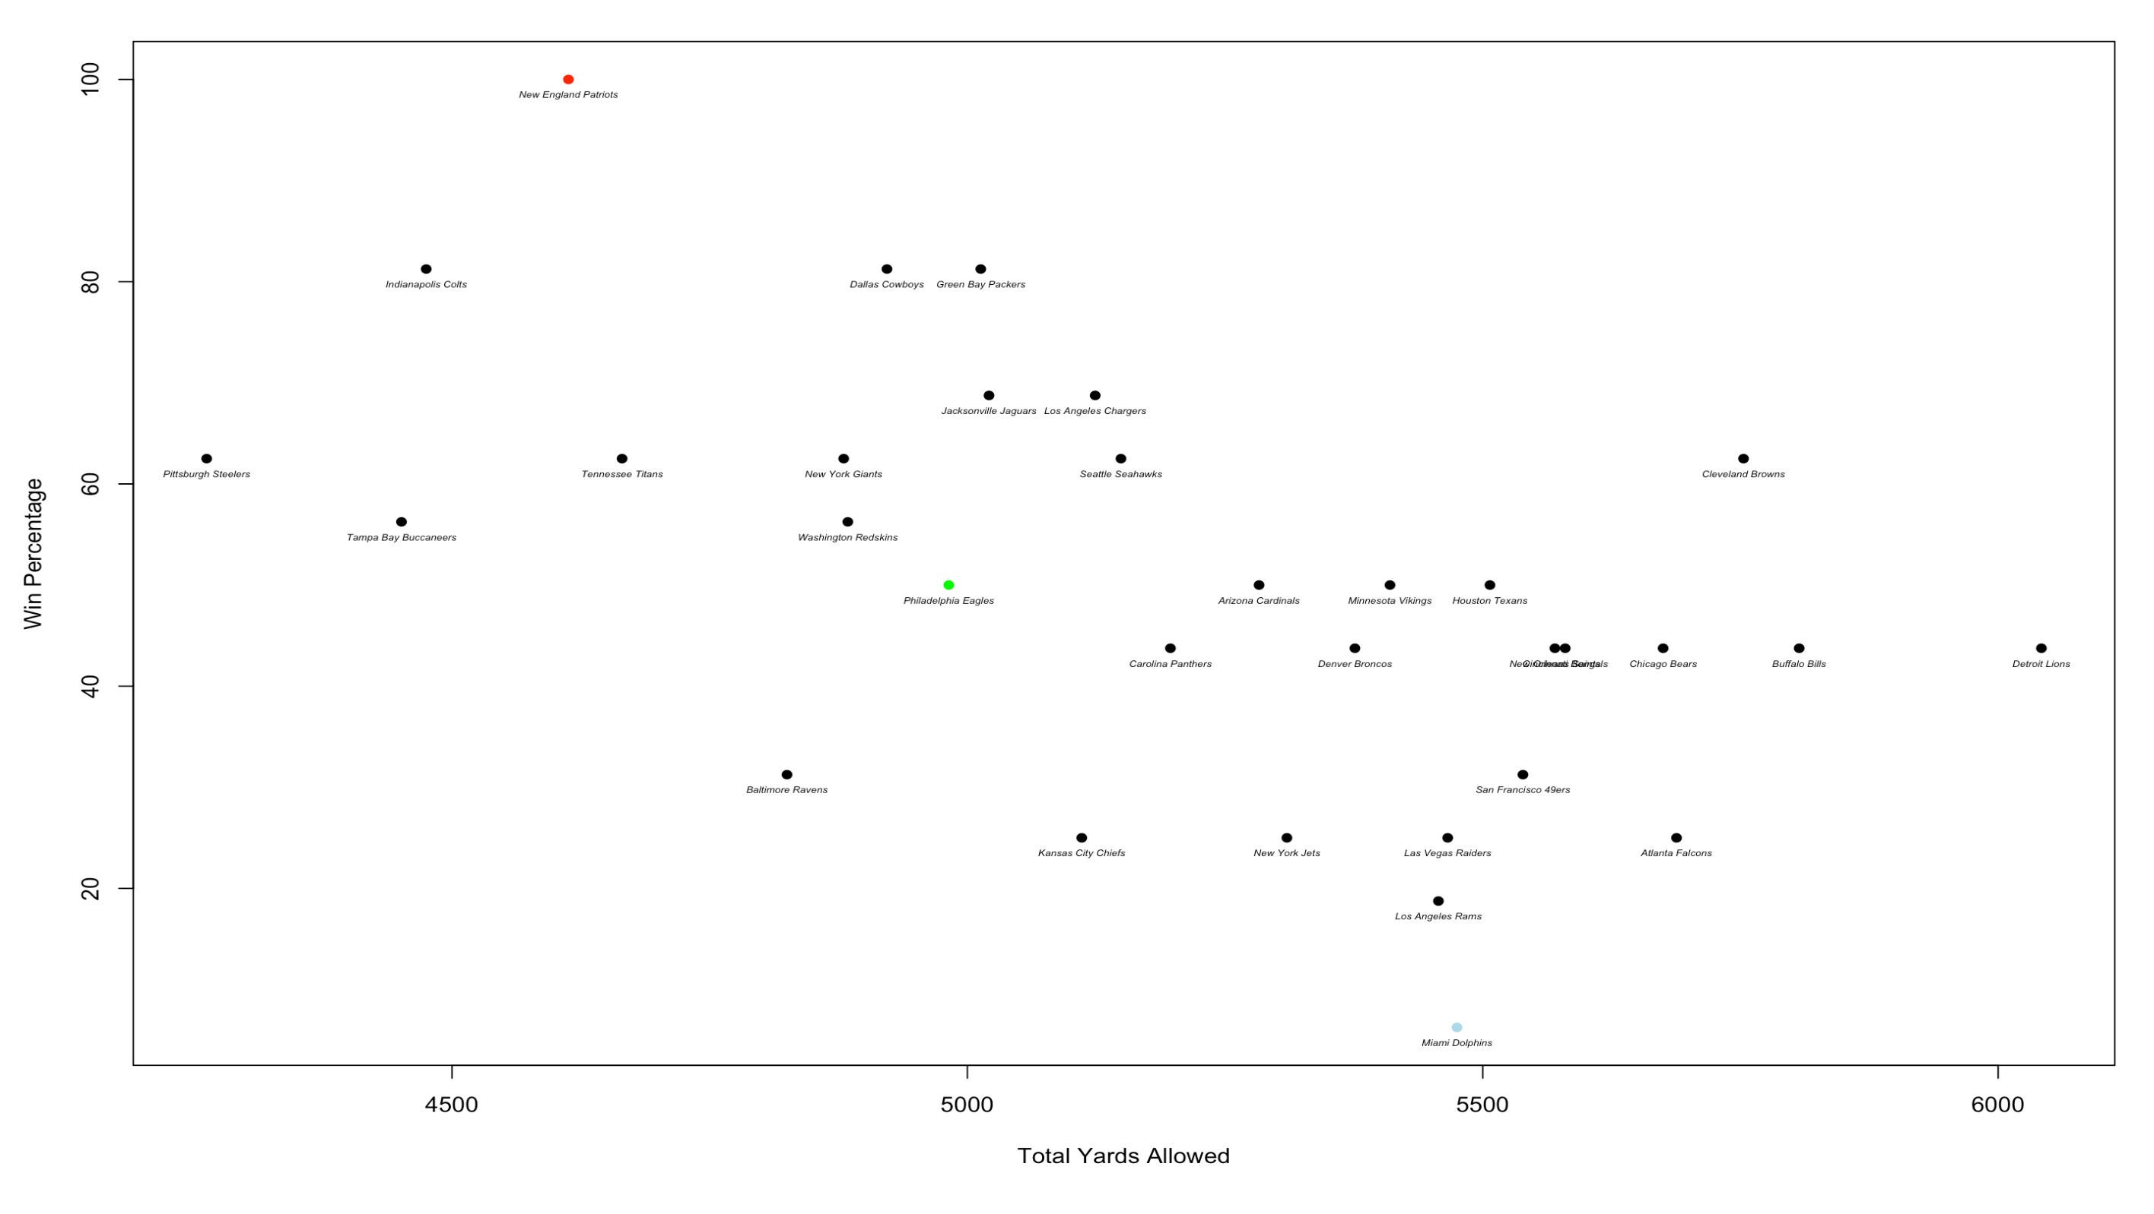
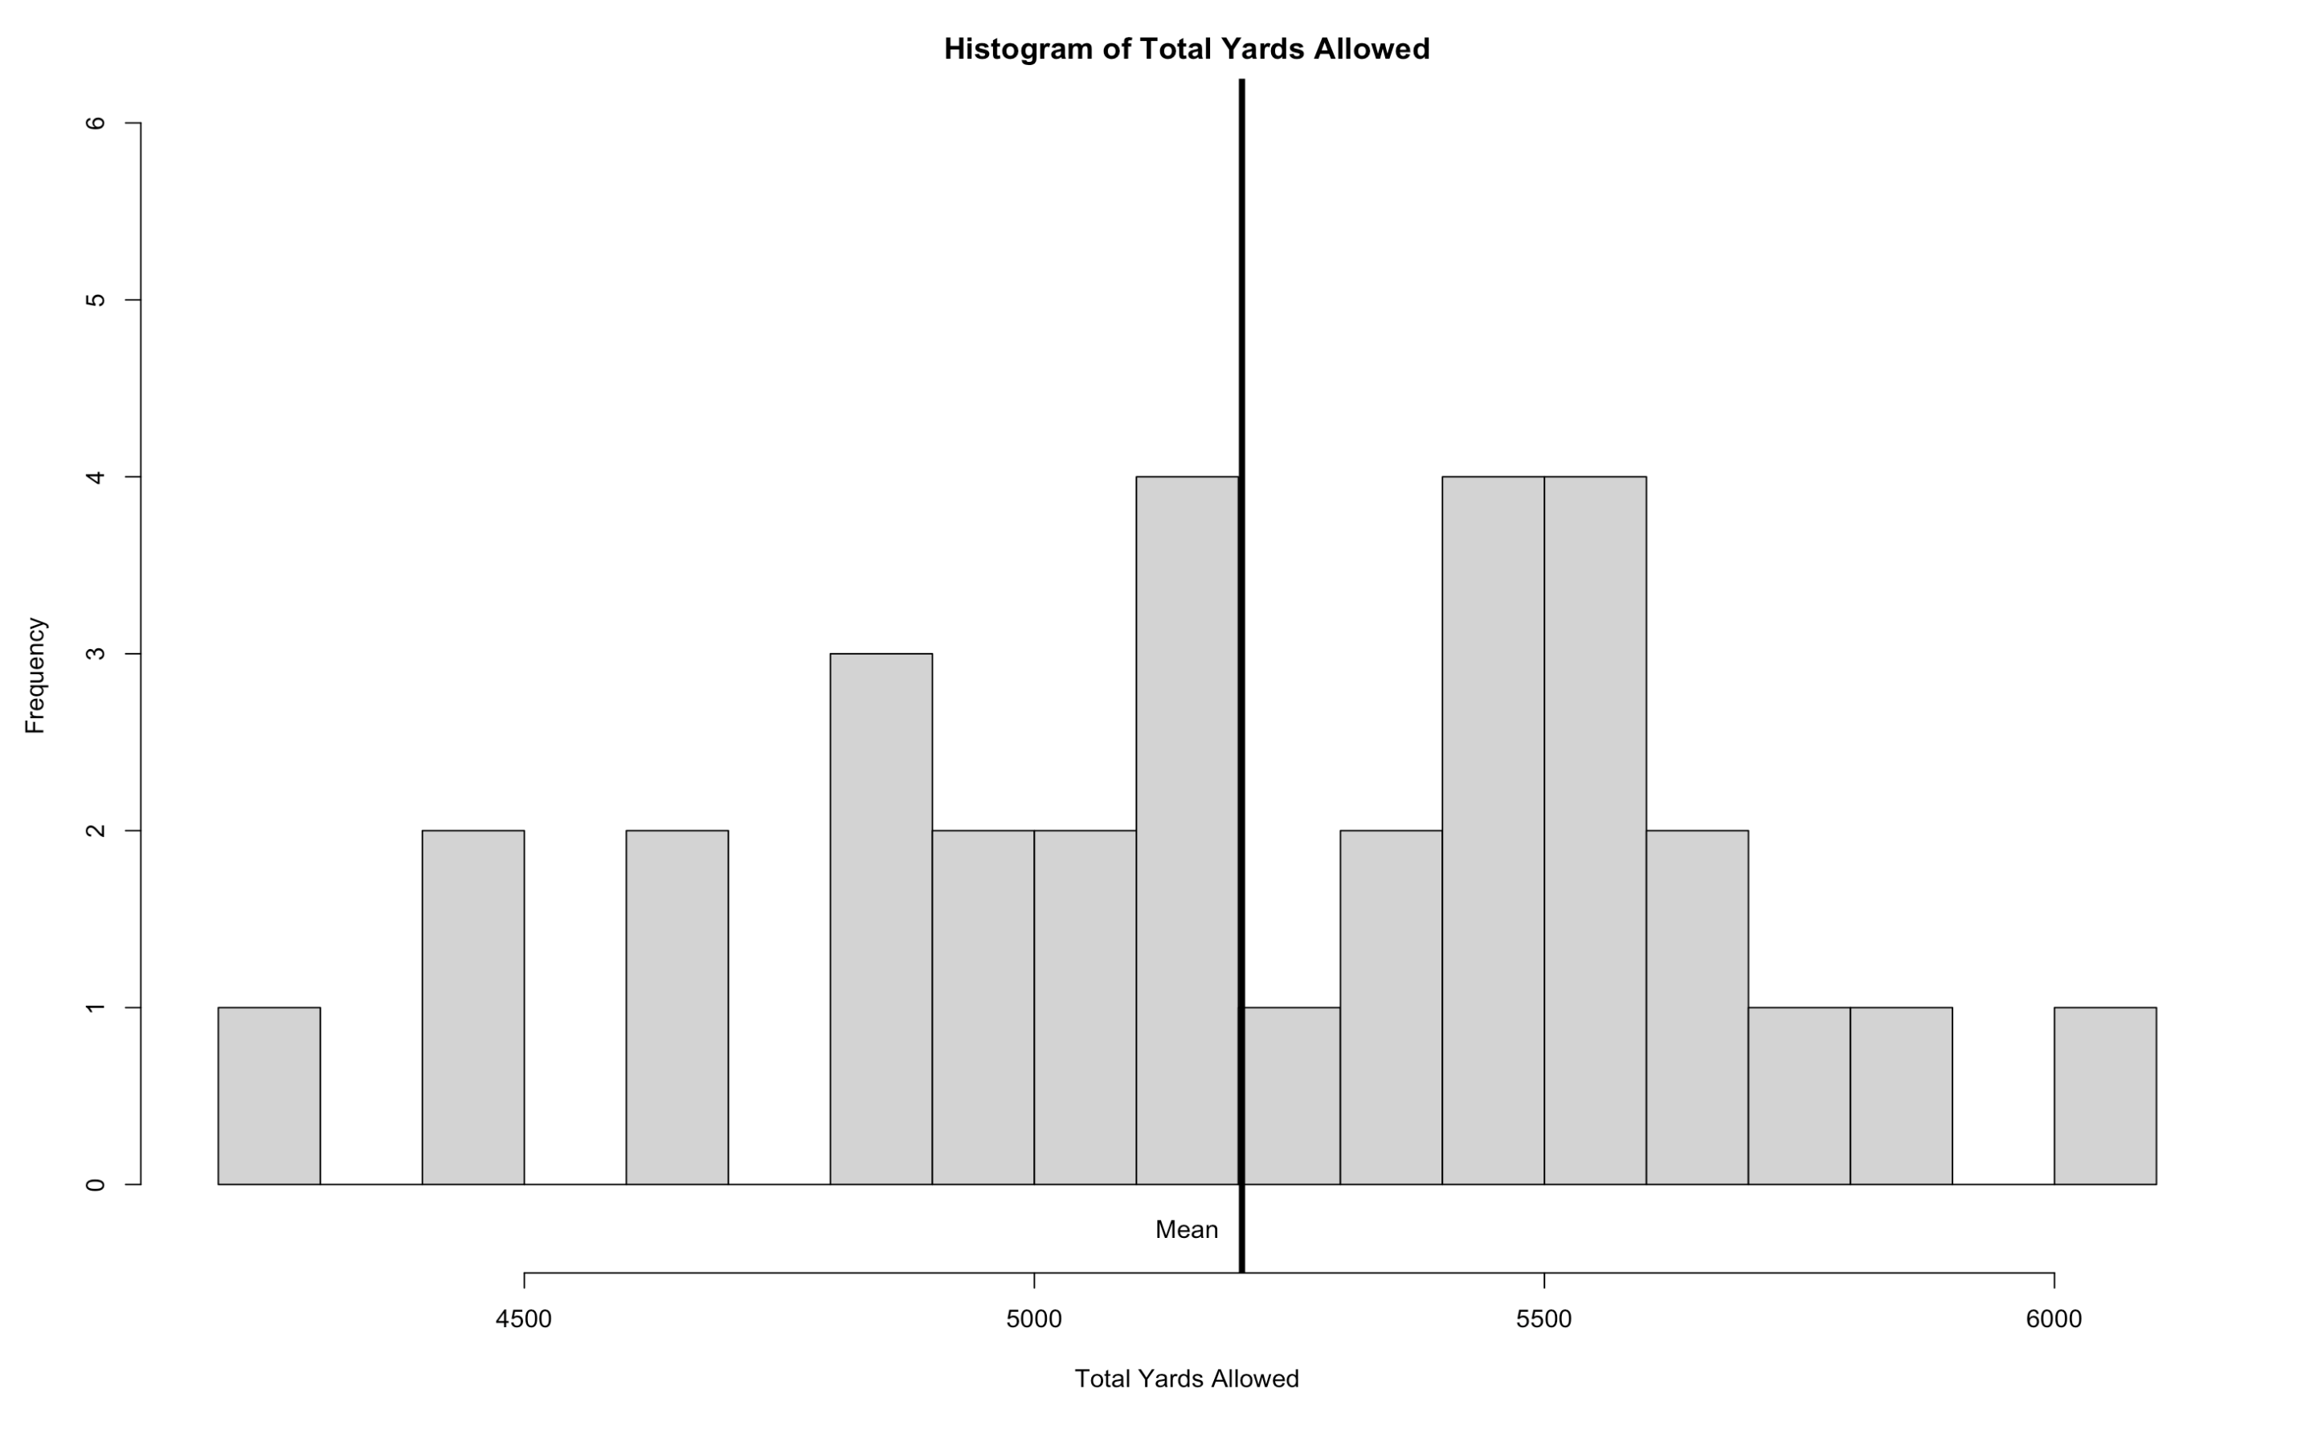
Relevant Statistics: Total Yards Allowed
We can see that the Total Yards Allowed has a moderate, negative correlation with Win Percentage
R = -0.54165413

Slide 17
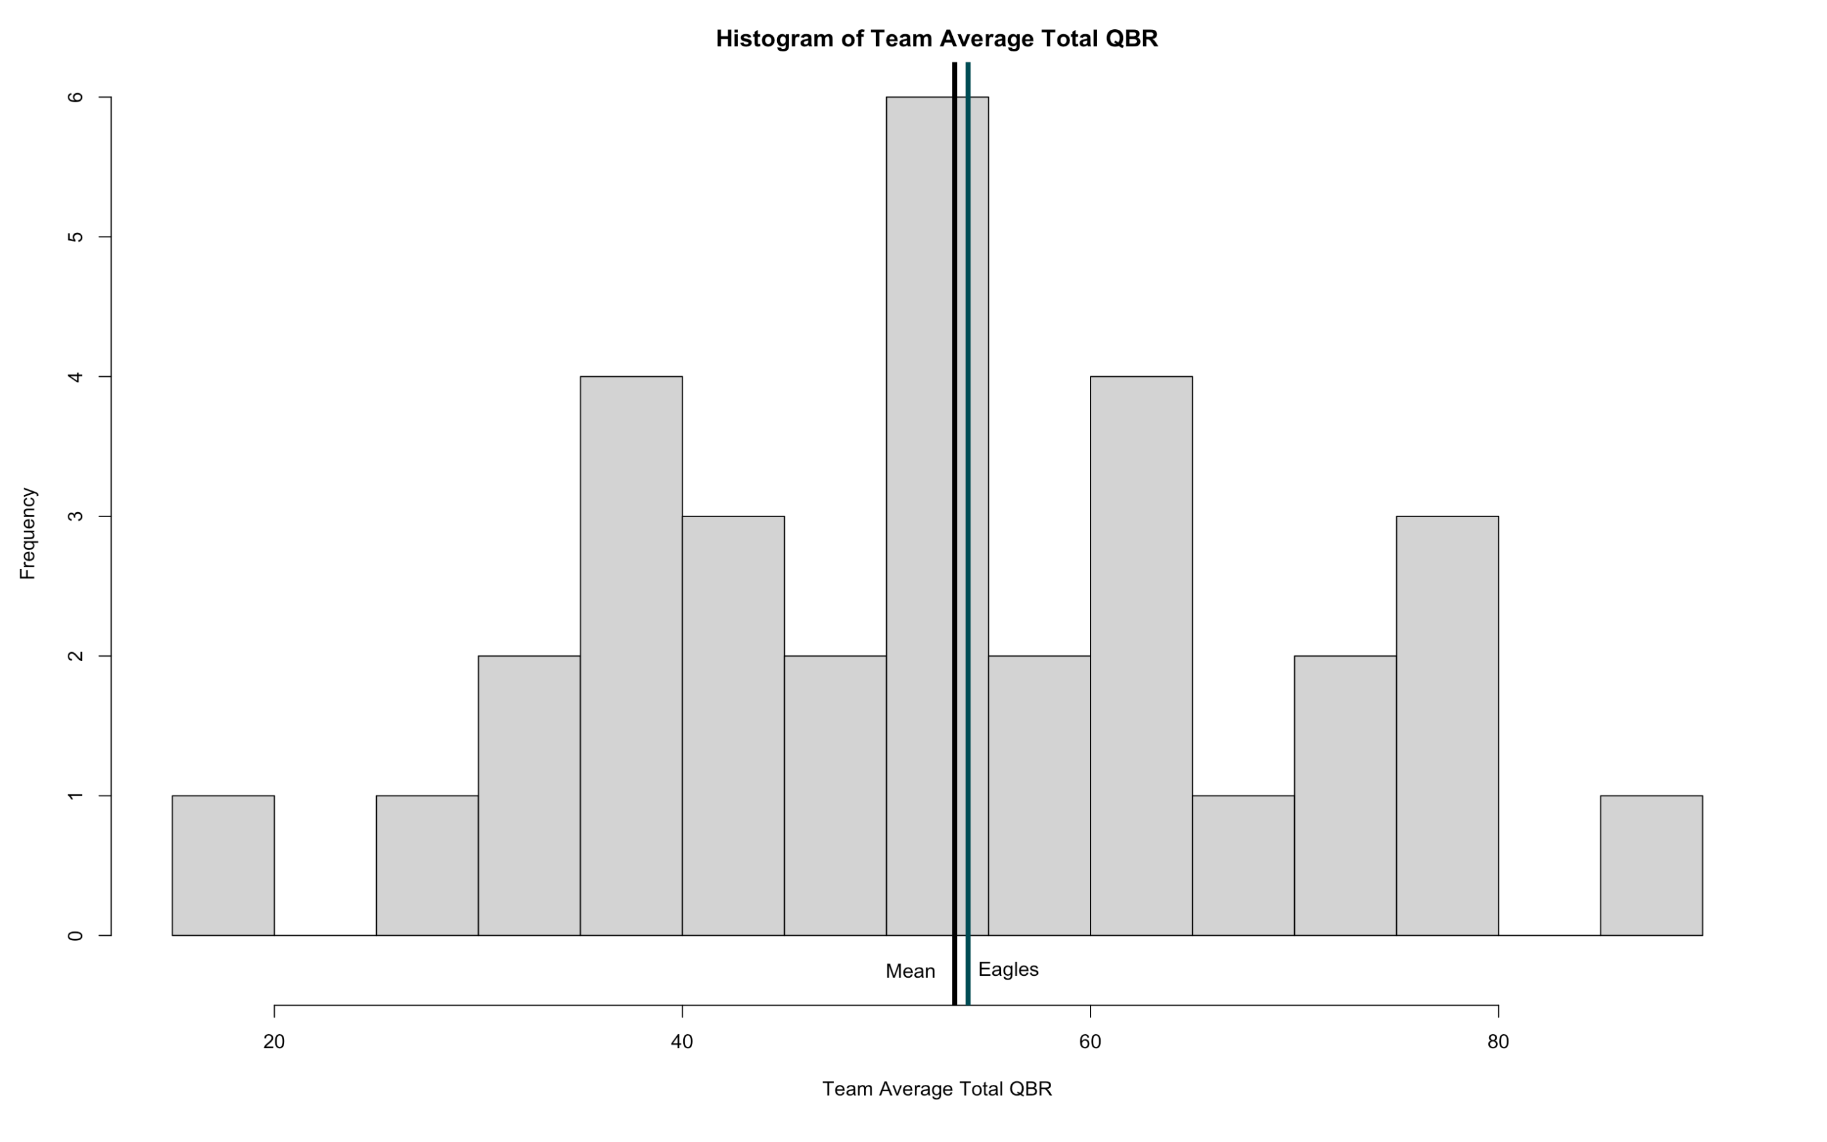
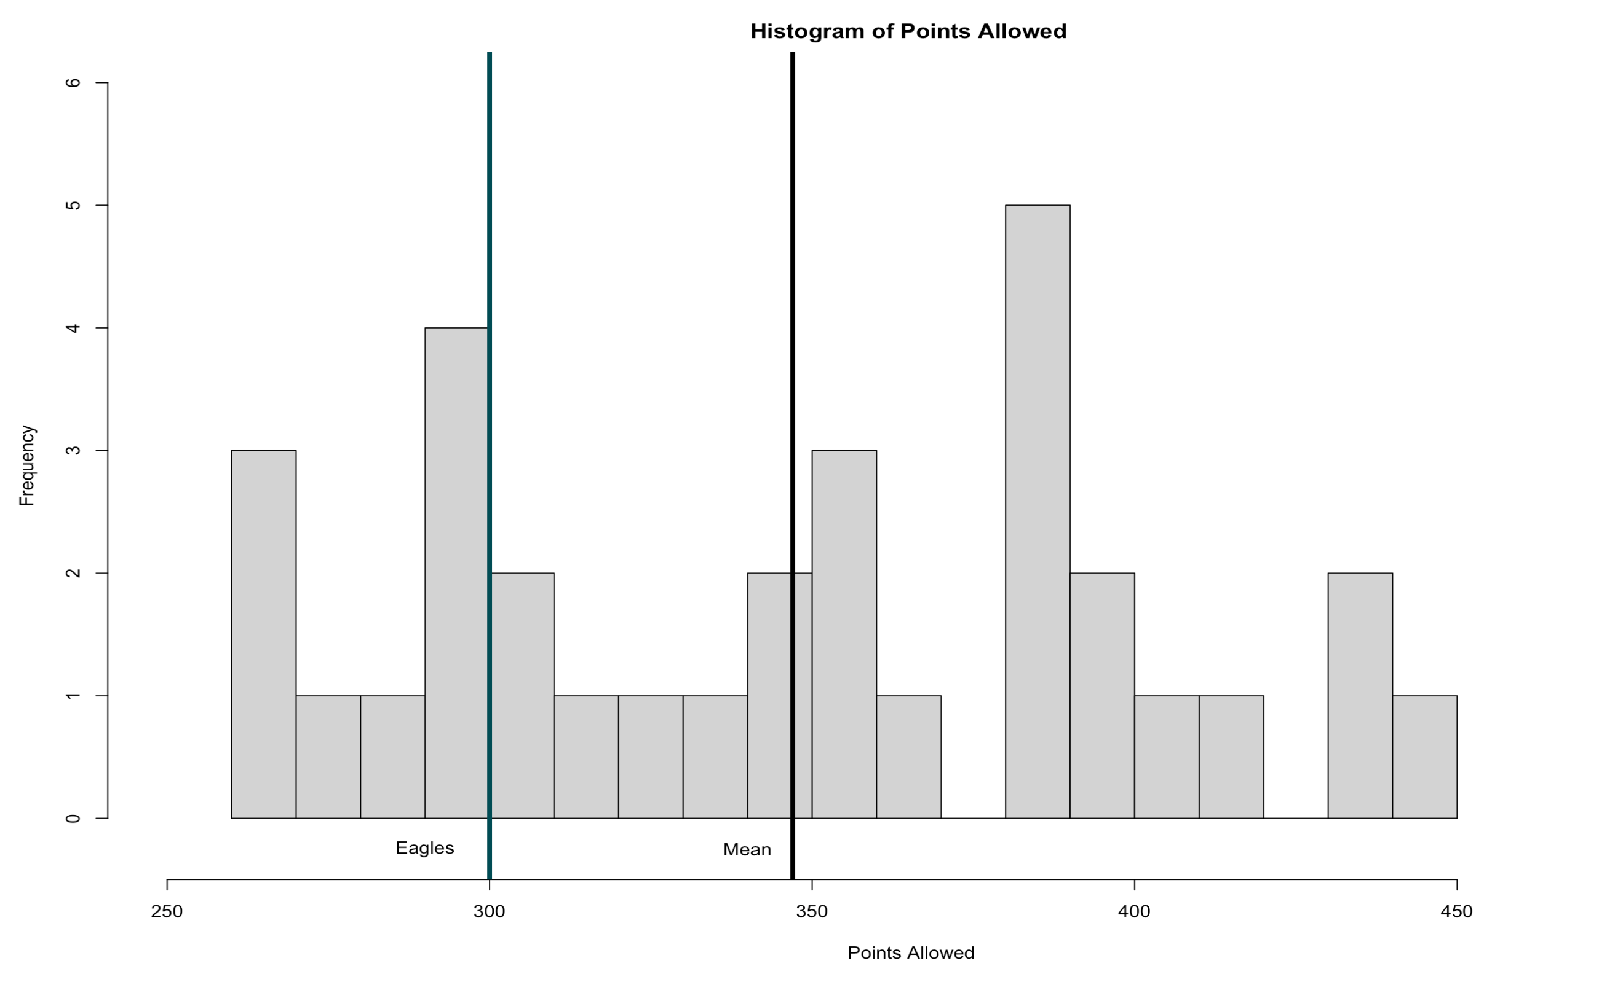
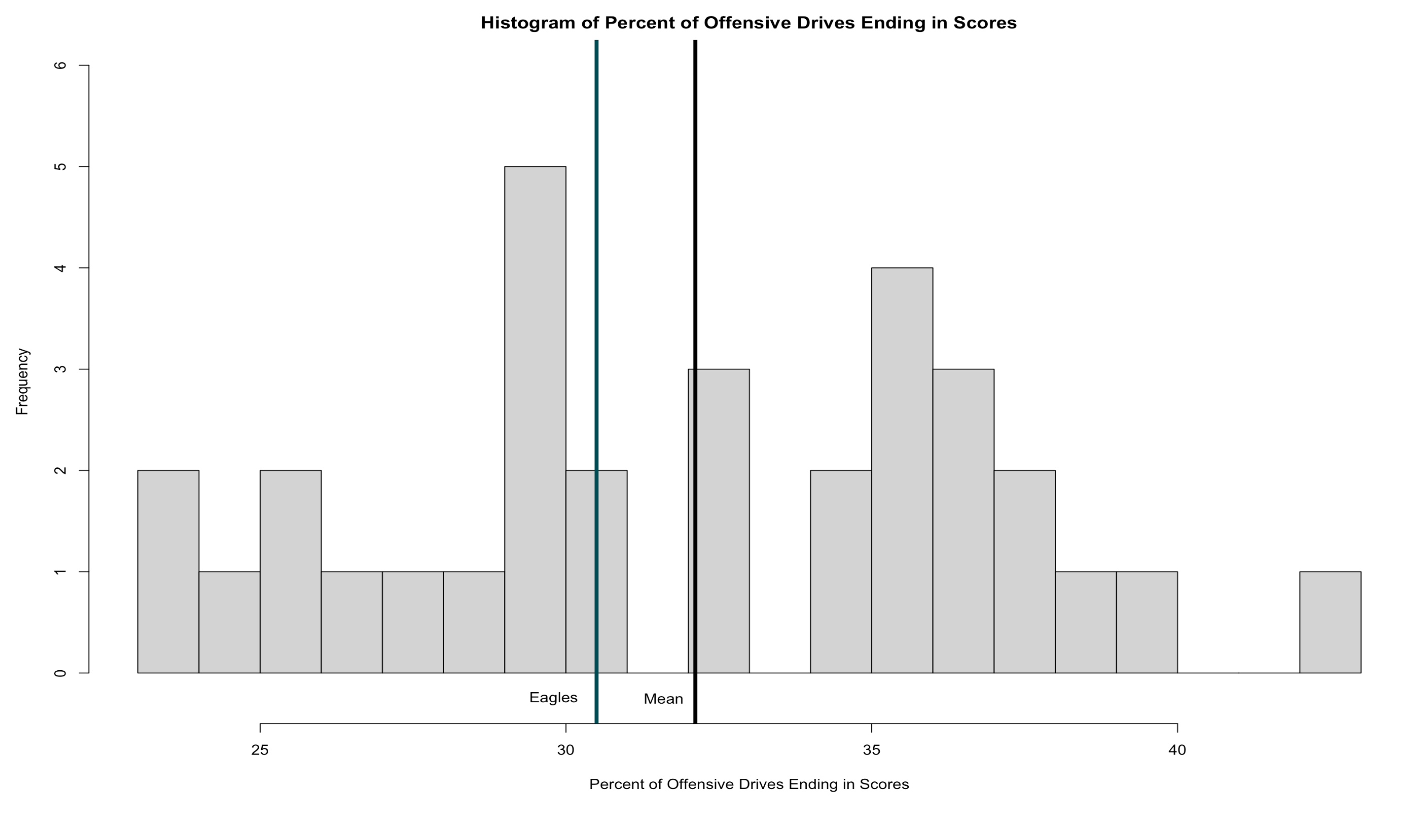
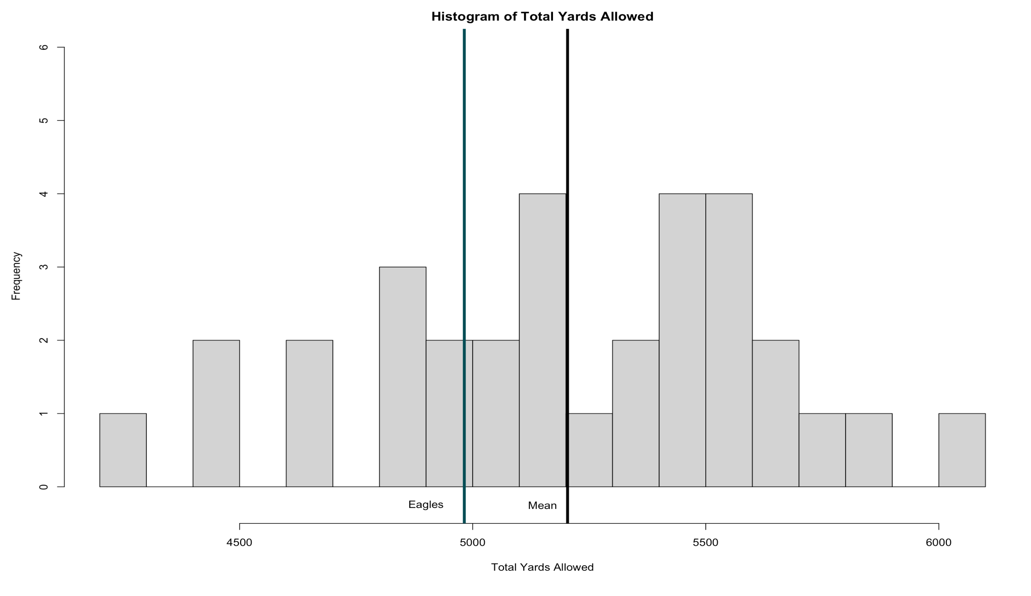
Analysis of Average Team
• The Eagles performed close to the league average or better for each of these variables and therefore had an average season.
T-test:
Statistic | P-Value
Total QBR | 0.8218
Points Allowed* | 2.933e-05
Yards Allowed* | 0.006823
Drives Resulting in Offensive Opponent Score | 0.07994
* Denotes team average is significantly different from league average

Slide 18
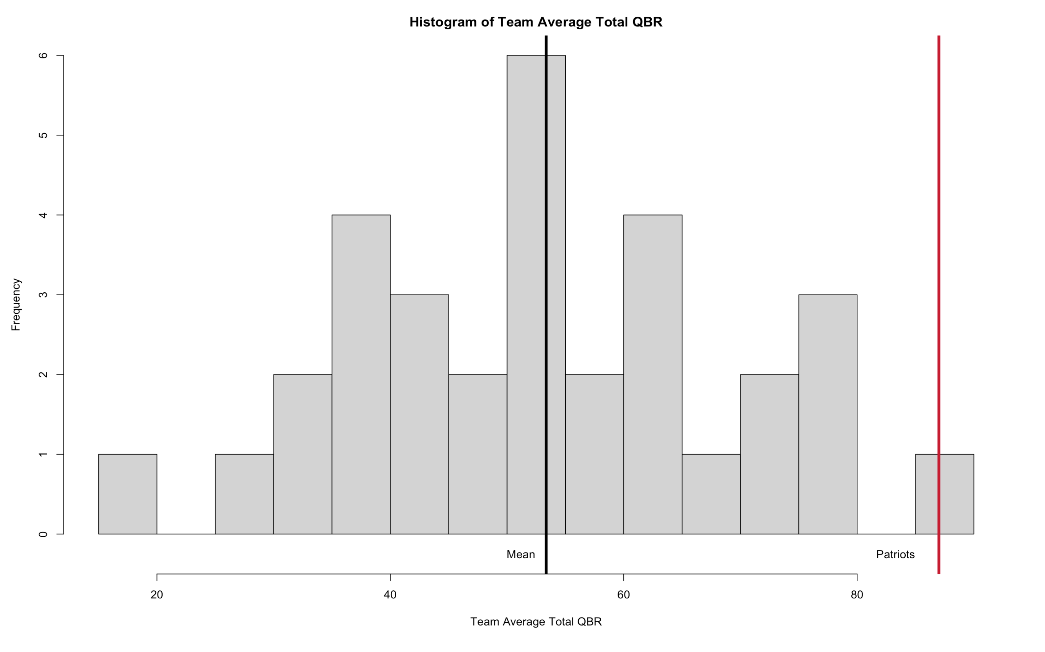
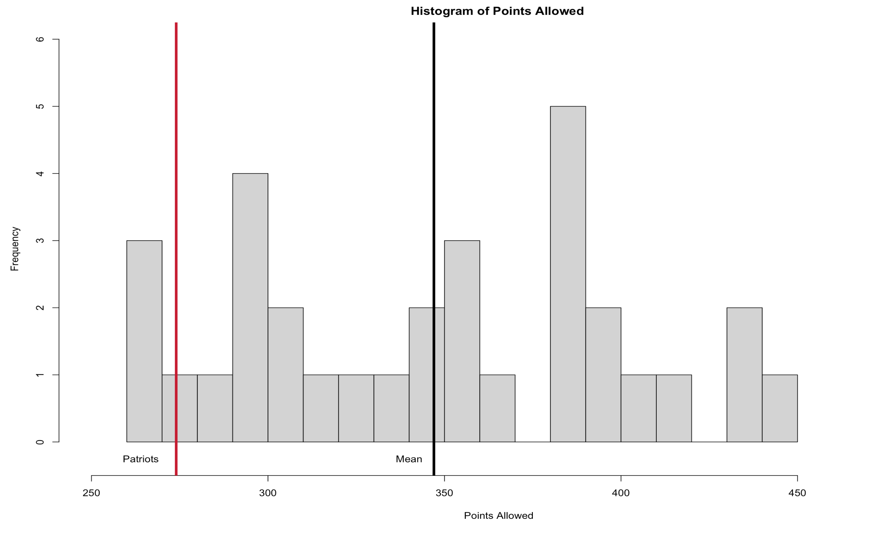
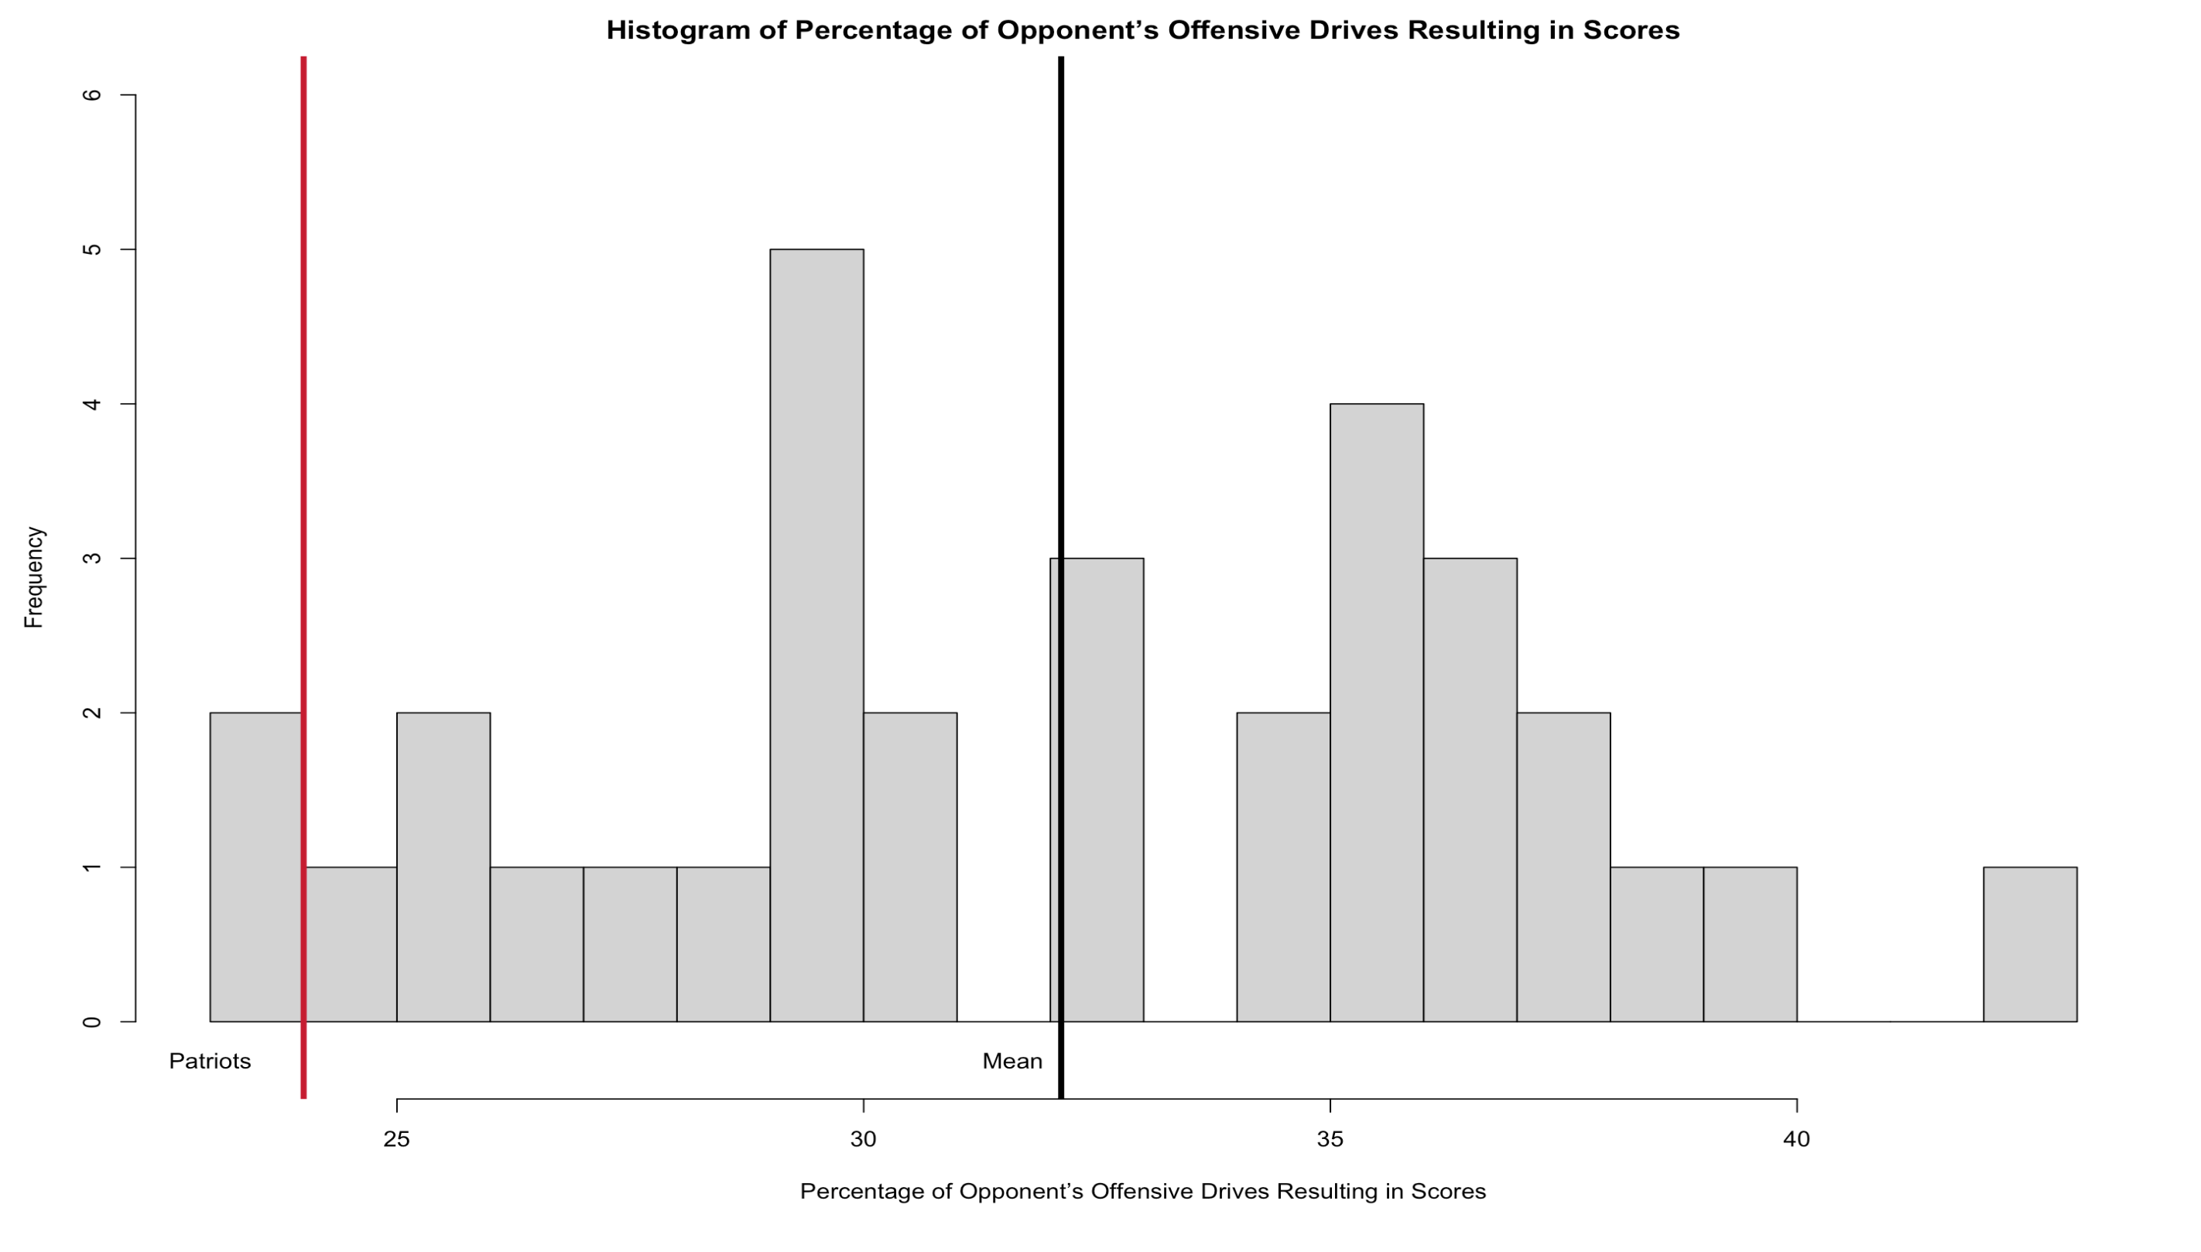
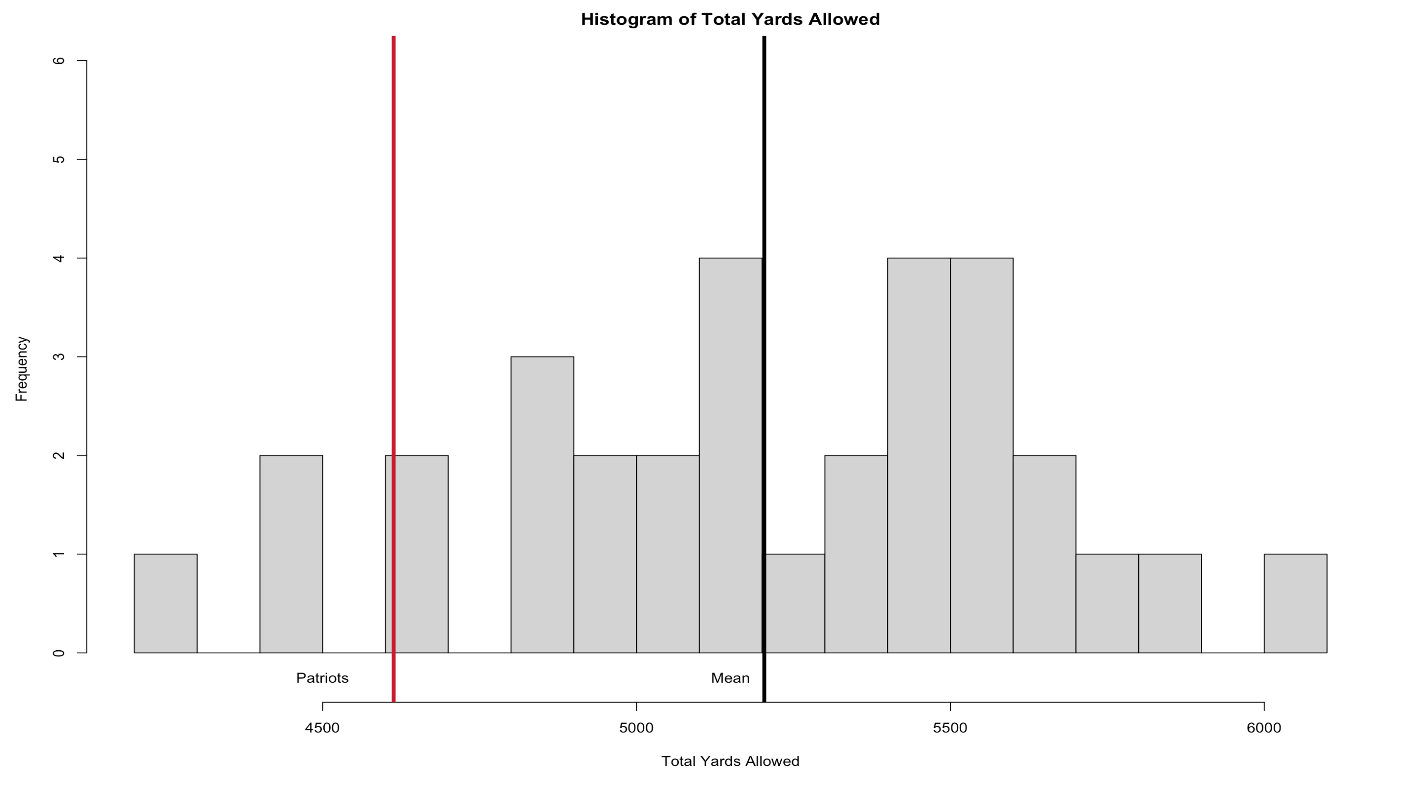
Analysis of Overachieving Team
• The Patriots performed significantly better than the league average for each of these variables and therefore had a more successful season than average.
T-test:
Statistic | P-Value
Total QBR* | 6.586e-13
Points Allowed* | 1.45e-08
Yards Allowed* | 1.02e-08
Drives Resulting in Offensive Opponent Score* | 2.945e-10
* Denotes team average is significantly different from league average

Slide 19
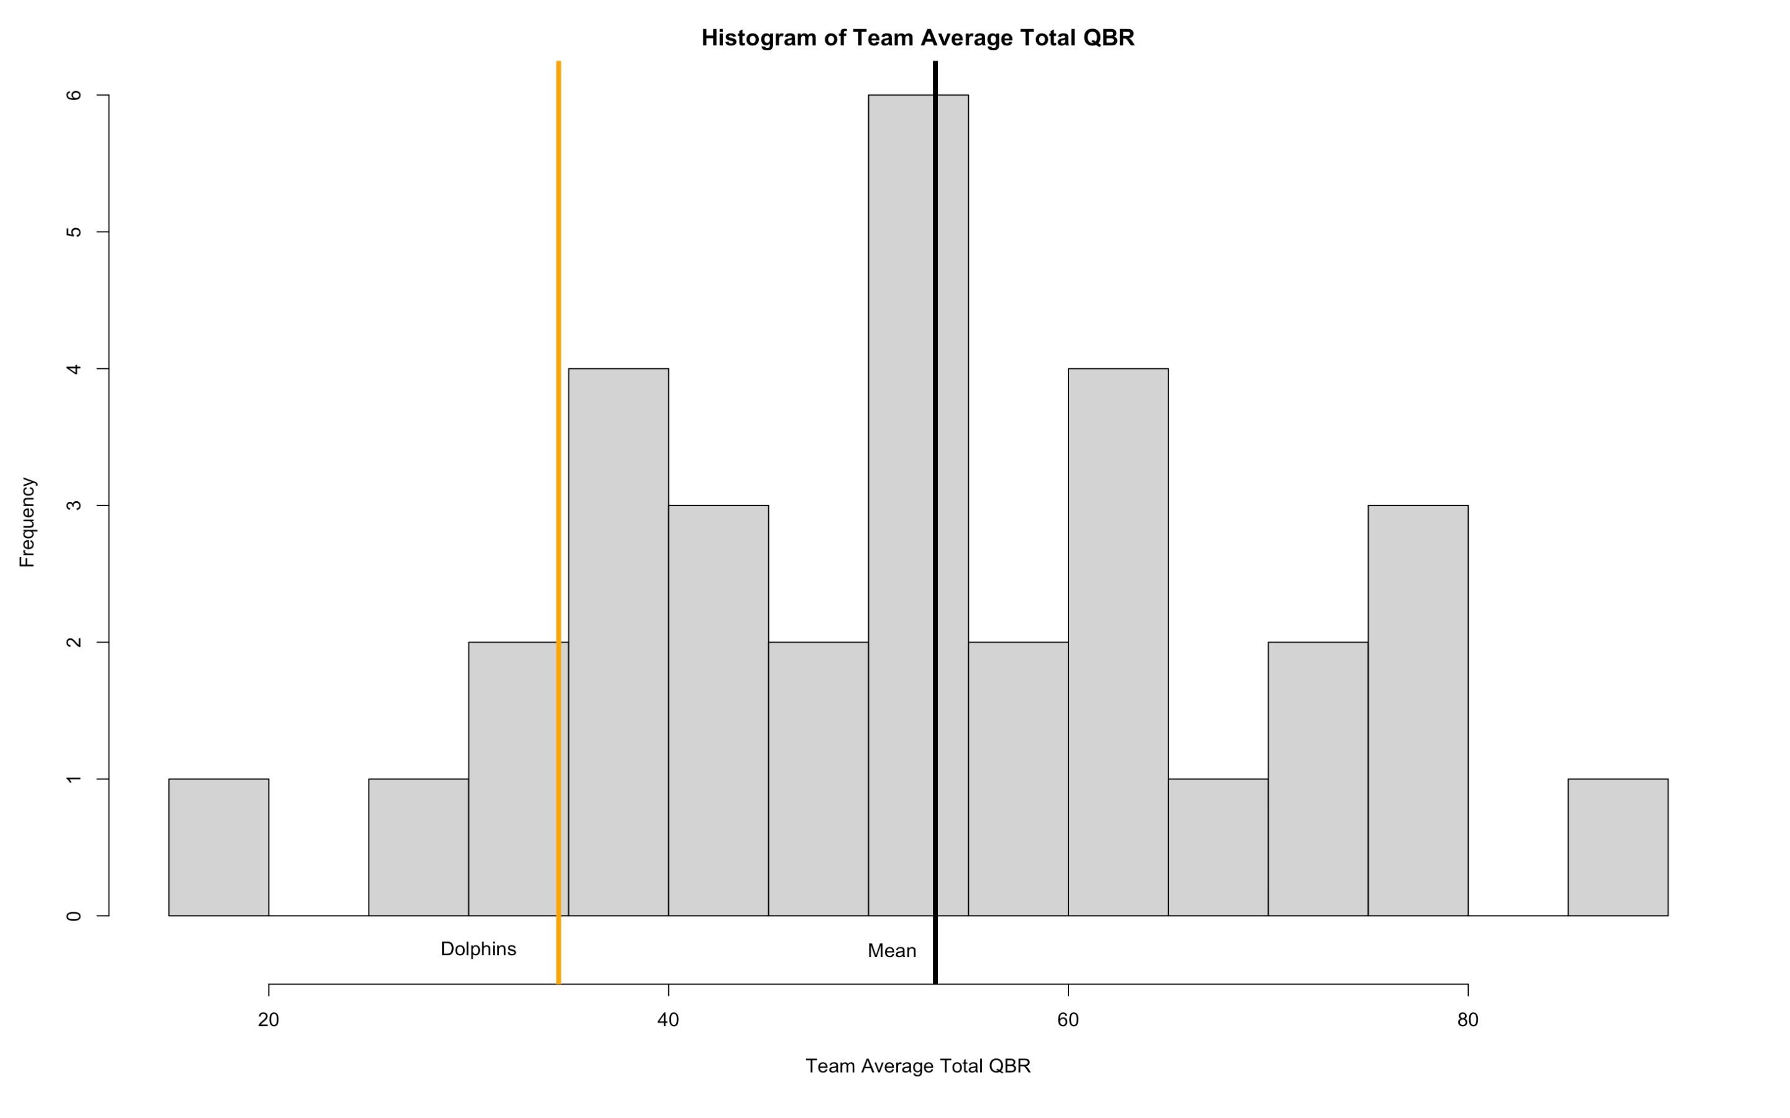
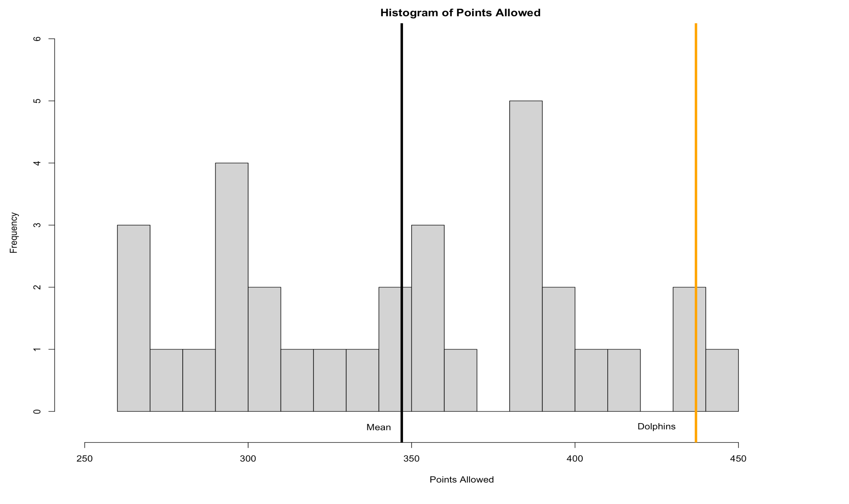
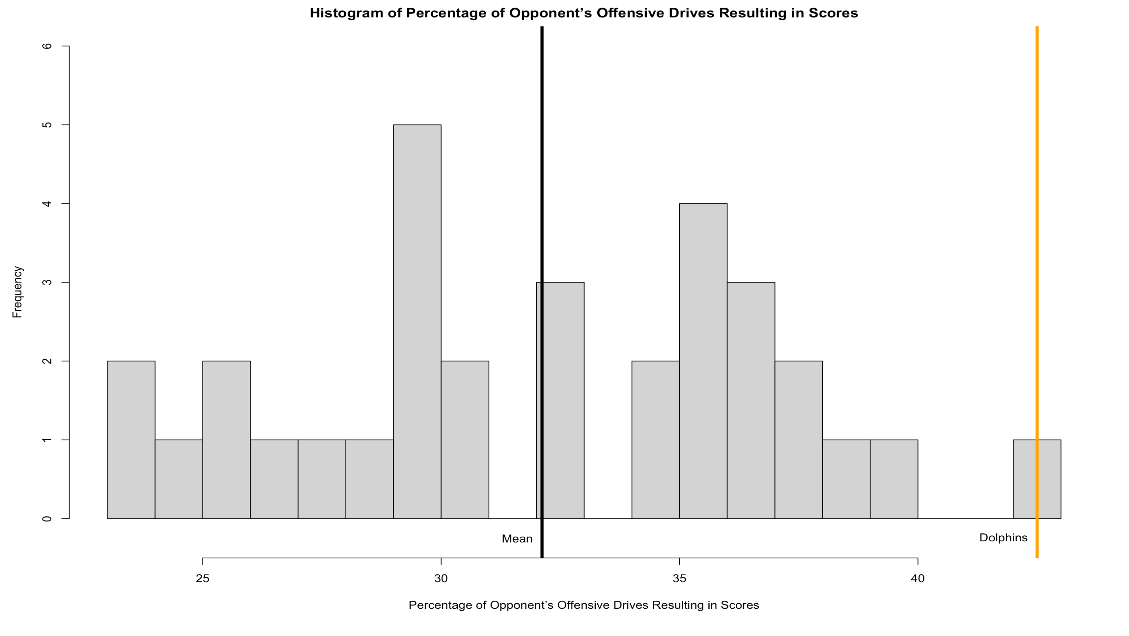
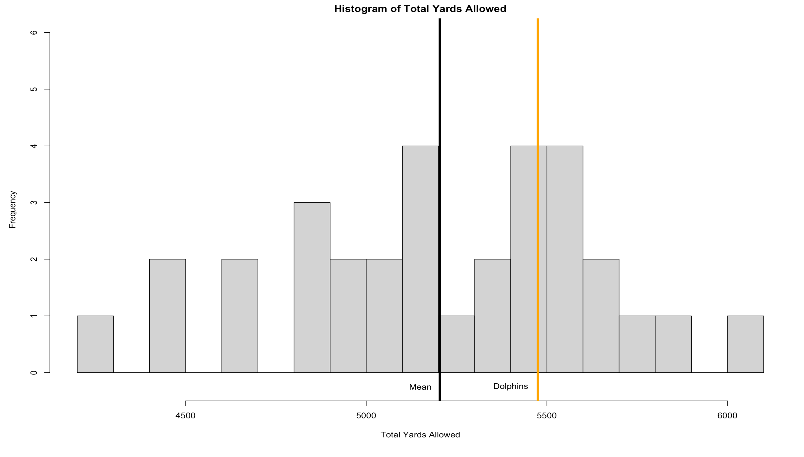
Analysis of Underachieving Team
• The Dolphins performed significantly worse than the league average for each of these variables and therefore had a below average season.
T-test:
Statistic | P-Value
Total QBR* | 2.559e-07
Points Allowed* | 1.495e-10
Yards Allowed* | 0.001242
Drives Resulting in Offensive Opponent Score* | 7.636e-13
* Denotes team average is significantly different from league average

Slide 20
Conclusions/Takeaways
The New England Patriots should have won Super Bowl XLII by a landslide
Highest QBR – Tom Brady
Defense with low offensive yards allowed, points allowed, offensive score percentage
Defensive statistics, such as total yards allowed, points allowed, and percentage of opponent’s offensive drives ending in scores, are important factors in the season performance of a team
It seems as if Total QBR is a very important factor in the season performance of a team
Offensive statistics didn’t correlate significantly with the season performance of a team
Moral of the Story: Try your best to have a phenomenal QB.
But even with a great quarterback, upsets are unavoidable in a sport like football.

